Slide 1
Electronics Devices & Circuits

Slide 2
UNIT-1
Multistage amplifier

Slide 3
Multistage amplifier
To increases the voltage gain of the amplifier, multiple amplifier are connected in cascade. The output of one amplifier is the input to another stage. In this way the overall voltage gain can be increased, when number of amplifier stages are used in succession it is called a multistage amplifier or cascade amplifier.
The load on the first amplifier is the input resistance of the second amplifier. The various stages need not have the same voltage and current gain. In practice, the earlier stages are often voltage amplifiers and the last one or two stages are power amplifiers.
The voltage amplifier stages assure that the power stages have the proper input swing. The amount of gain in a stage is determined by the load on the amplifier stage, which is governed by the input resistance to the next stage.
Therefore, in designing or analysing multistage amplifier, we start at the output and proceed toward the input.

Slide 4
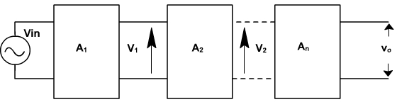
A n-stage amplifier can be represented by the block diagram as shown in fig.
The overall voltage gain is the product of the voltage gain of each stage.
A = A1×A2 ×………× An.

Slide 5
Gain in dB
To represent the gain of the cascade amplifier, the voltage gain is represented in dB. The two power levels of input and output of an amplifier are compared on a logarithmic scale rather than linear scale. The number of bels by which the output power P₂ exceeds the input power P₁ is defined as

Slide 6
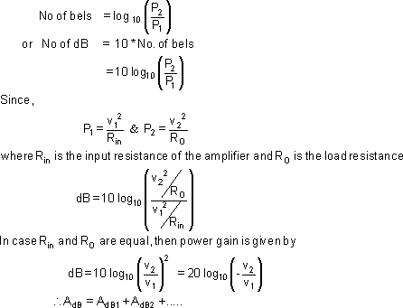
Because of dB scale the gain can be directly added when a number of stages are cascaded.

Slide 7
Types of Coupling
The three couplings generally used are.
RC coupling
Transformer coupling
Direct Coupling

Slide 8
RC coupling
RC coupling the most commonly used method of coupling from one stage to the next. An ac source with a source resistance Rs drives the input of an amplifier. The grounded emitter stage amplifies the signal, which is then coupled to next CE stage the signal is further amplified to get larger output.
In this case the signal developed across the collector resistor of each stage is coupled into the base of the next stage. The cascaded stages amplify the signal and the overall gain equals the product of the individual gains.

Slide 9
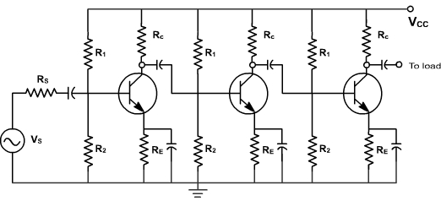
RC coupling

Slide 10
RC coupling
The coupling capacitors pass ac but block dc Because of this the stages are isolated as for as dc is concerned. This is necessary to avoid shifting of Q-points. The drawback of this approach is the lower frequency limit imposed by the coupling capacitor.
The bypass capacitors are needed because they bypass the emitters to ground. Without them, the voltage gain of each stage would be lost. These bypass capacitors also place a lower limit on the frequency response. As the frequency keeps decreasing, a point is reached at which capacitors no longer look like a.c. shorts. At this frequency the voltage gain starts to decrease because of the local feedback and the overall gain of the amplifier drops significantly. These amplifiers are suitable for frequencies above 10 Hz.

Slide 11
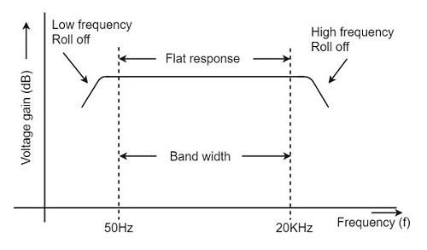
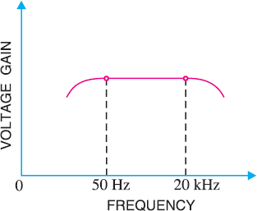
Frequency response curve

Slide 12
Advantages of RC Coupled Amplifier:
The frequency response of RC amplifier provides constant gain over a wide frequency range, hence most suitable for audio applications.
The circuit is simple and has lower cost because it employs resistors and capacitors which are cheap.
It becomes more compact with the upgrading technology.
Disadvantages of RC Coupled Amplifier:
The voltage and power gain are low because of the effective load resistance.
They become noisy with age.
Due to poor impedance matching, power transfer will be low.
Applications of RC Coupled Amplifier
They have excellent audio fidelity over a wide range of frequency.
Widely used as Voltage amplifiers
Due to poor impedance matching, RC coupling is rarely used in the final stages.

Slide 13
Transformer Coupled Amplifier
We have observed that the main drawback of RC coupled amplifier is that the effective load resistance gets reduced. This is because, the input impedance of an amplifier is low, while its output impedance is high.
When they are coupled to make a multistage amplifier, the high output impedance of one stage comes in parallel with the low input impedance of next stage. Hence, effective load resistance is decreased. This problem can be overcome by a transformer coupled amplifier.
In a transformer-coupled amplifier, the stages of amplifier are coupled using a transformer.

Slide 14
Construction of Transformer Coupled Amplifier
The amplifier circuit in which, the previous stage is connected to the next stage using a coupling transformer, is called as Transformer coupled amplifier.
The coupling transformer T₁ is used to feed the output of
₂nd
1ststage to the input of stage. The collector load is
replaced by the primary winding of the transformer.
The secondary winding is connected between the potential divider and the base of 2ndstage, which provides the input to the 2nd stage.
Instead of coupling capacitor like in RC coupled amplifier, a transformer is used for coupling any two stages, in the transformer coupled amplifier circuit.

Slide 15
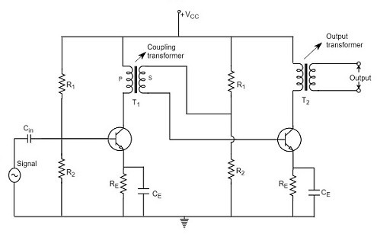
Circuit diagram of transformer coupled amplifier

Slide 16
The potential divider network R₁ and R₂ and the resistor R_{e} together form the biasing and stabilization network. The emitter by-pass capacitor C_{e} offers a low reactance path to the signal. The resistor R_{L} is used as a load impedance. The input capacitor C_{in} present at the initial stage of the amplifier couples AC signal to the base of the transistor. The capacitor C_{C} is the coupling capacitor that connects two stages and prevents DC interference between the stages and controls the shift of operating point.

Slide 17
Operation of Transformer Coupled Amplifier
When an AC signal is applied to the input of the base of the first transistor then it gets amplified by the transistor and appears at the collector to which the primary of the transformer is connected.
The transformer which is used as a coupling device in this circuit has the property of impedance changing, which means the low resistance of a stage (or load) can be reflected as a high load resistance to the previous stage. Hence the voltage at the primary is transferred according to the turns ratio of the secondary winding of the transformer.
This transformer coupling provides good impedance matching between the stages of amplifier. The transformer coupled amplifier is generally used for power amplification.

Slide 18
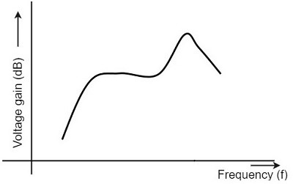
Frequency Response of Transformer Coupled Amplifier

Slide 19
The gain of the amplifier is constant only for a small range of frequencies. The output voltage is equal to the collector current multiplied by the reactance of primary.
At low frequencies, the reactance of primary begins to fall,
resulting in decreased gain. At high frequencies, the capacitance between turns of windings acts as a bypass condenser to reduce the output voltage and hence gain.
So, the amplification of audio signals will not be proportionate
and some distortion will also get introduced, which is called
as Frequency distortion.

Slide 20
Advantages
An excellent impedance matching is provided.
Gain achieved is higher.
There will be no power loss in collector and base resistors.
Efficient in operation.
Disadvantages
Though the gain is high, it varies considerably with frequency.
Hence a poor frequency response.
Frequency distortion is higher.
Transformers tend to produce hum noise.
Transformers are bulky and costly.
Applications
Mostly used for impedance matching purposes.
Used for Power amplification.
Used in applications where maximum power transfer is needed.

Slide 21
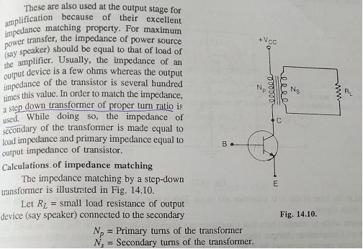
Impedence Matching

Slide 22
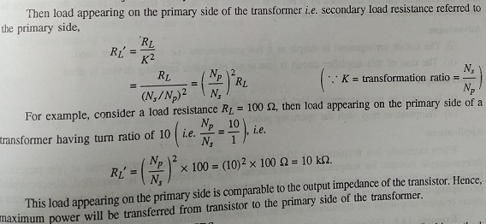

Slide 23
Direct Coupled Amplifier
As no coupling devices are used, the coupling of the amplifier stages is done directly and hence called as Direct coupled amplifier.
Especially used to amplify lower frequencies, such as amplifying photo-electric current or thermo-couple current or so.

Slide 24
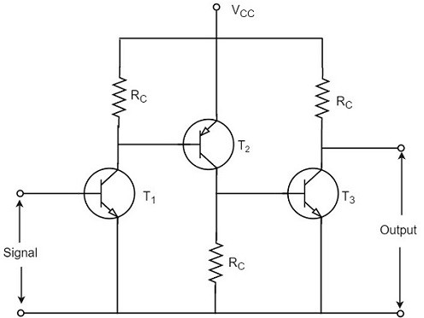
Construction
The figure below indicates the three stage direct coupled transistor amplifier. The output of first stage transistor T₁ is connected to the input of second stage transistor T₂.

Slide 25
The transistor in the first stage will be an NPN transistor, while the transistor in the next stage will be a PNP transistor and so on. This is because, the variations in one transistor tend to cancel the variations in the other. The rise in the collector current and the variation in β of one transistor gets cancelled by the decrease in the other.

Slide 26
Operation
The input signal when applied at the base of transistor T₁, it gets amplified due to the transistor action and the amplified output appears at the collector resistor R_{c} of transistor T₁. This output is applied to the base of transistor T₂ which further amplifies the signal. In this way, a signal is amplified in a direct coupled amplifier circuit.

Slide 27
Advantages
The circuit arrangement is simple because of minimum use of
resistors.
The circuit is of low cost because of the absence of expensive
coupling devices.
Disadvantages
It cannot be used for amplifying high frequencies.
The operating point is shifted due to temperature variations.
Applications
Low frequency amplifications.
Low current amplifications.

Slide 28
UNIT-2
Large Signal Amplifier

Slide 29

Power Amplifier
After the audio signal is converted into electrical signal, it has several voltage amplifications done, after which the power amplification of the amplified signal is done just before the loud speaker stage. This is clearly shown in the below figure.

Slide 30
While the voltage amplifier raises the voltage level of the signal, the power amplifier raises the power level of the signal. Besides raising the power level, it can also be said that a power amplifier is a device which converts DC power to AC power and whose action is controlled by the input signal.
The DC power is distributed according to the relation, DC power input = AC power output + losses

Slide 31
Voltage Amplifier
The voltage gain of an amplifier is given by :
Av=β(Rc/Rin)
The characteristics of a voltage amplifier are as follows:
The base of the transistor should be thin and hence the value of β should be greater than 100.
The resistance of the input resistor R_{in} should be low when compared to collector load R_{C}.
The collector load R_{C} should be relatively high. To permit high collector load, the voltage amplifiers are always operated at low collector current.
The voltage amplifiers are used for small signal voltages.

Slide 32
Power Transistor
It is larger in size, in order to handle large powers.
The collector region of the transistor is made large and a heat sink is placed at the collector-base junction in order to minimize heat generated.
The emitter and base regions of a power transistor are heavily doped.
Due to the low input resistance, it requires low input power.

Slide 33
Difference between Voltage and Power Amplifiers
S.No | Particular | Voltage Amplifier | Power Amplifier
1 | β | High (>100) | Low (5 to 20)
2 | RC | High (4-10 KΩ) | Low (5 to 20 Ω)
3 | Coupling | Usually R-C coupling | Invariably transformer coupling
4 | Input voltage | Low (a few m V) | High (2-4 V)
5 | Collector current | Low (≈ 1 mA) | High (> 100 mA)
6 | Power output | Low | High
7 | Output impendence | High (≈ 12 K Ω) | Low (200 Ω)

Slide 34
Classification Based on Mode of Operation
Class A Power amplifier − When the collector current flows at all times during the full cycle of signal, the power amplifier is known as class A power amplifier.
Class B Power amplifier − When the collector current flows only during the positive half cycle of the input signal, the power amplifier is known as class B power amplifier.
Class C Power amplifier − When the collector current flows for less than half cycle of the input signal, the power amplifier is known as class C power amplifier.
Class AB amplifier - if we combine the class A and class B amplifiers so as to utilize the advantages of both.

Slide 35
Class A Power Amplifiers
A Class A power amplifier is one in which the output current flows for the entire cycle of the AC input supply. Hence the complete signal present at the input is amplified at the output.

Slide 36
The operating point of this amplifier is present in the linear region. It is so selected that the current flows for the entire ac input cycle. The below figure explains the selection of operating point. The output characteristics with operating point Q is shown in the figure above. Here (I_{c})_{Q} and (V_{ce})_{Q} represent no signal collector current and voltage between collector and emitter respectively. When signal is applied, the Q-point shifts to Q₁ and Q₂. The output current increases to (I_{c})_{max} and decreases to (I_{c})_{min}. Similarly, the collector-emitter voltage increases to (V_{ce})_{max} and decreases to ^{(V}ce⁾min.

Slide 37
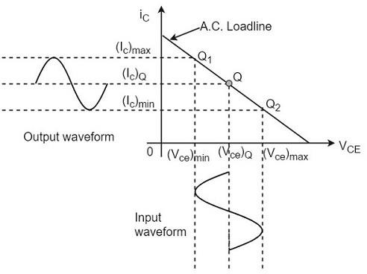

Slide 38
Advantages of Class A Amplifiers
The current flows for complete input cycle
It can amplify small signals
The output is same as input
No distortion is present
Disadvantages of Class A Amplifiers
Low power output
Low collector efficiency

Slide 39
Class B Power Amplifier
When the collector current flows only during the positive half cycle of the input signal, the power amplifier is known as class B power amplifier.
Class B Operation
The biasing of the transistor in class B operation is in such a way that at zero signal condition, there will be no collector current. The operating point is selected to be at collector cut off voltage. So, when the signal is applied, only the positive half cycle is amplified at the output.

Slide 40
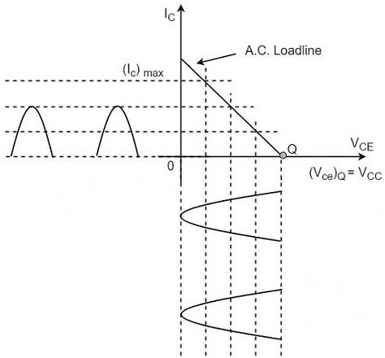
The figure below shows the input and output waveforms during class B operation.

Slide 41
When the signal is applied, the circuit is forward biased for the positive half cycle of the input and hence the collector current flows. But during the negative half cycle of the input, the circuit is reverse biased and the collector current will be absent. Hence only the positive half cycle is amplified at the output.
As the negative half cycle is completely absent, the signal distortion will be high. Also, when the applied signal increases, the power dissipation will be more. But when compared to class A power amplifier, the output efficiency is increased.
Well, in order to minimize the disadvantages and achieve low distortion, high efficiency and high output power, the push-pull configuration is used in this class B amplifier.

Slide 42
Class C Power Amplifier
When the collector current flows for less than half cycle of the input signal, the power amplifier is known as class C power amplifier.
The efficiency of class C amplifier is high while linearity is poor. The conduction angle for class C is less than 180º. It is generally around 90º, which means the transistor remains idle for more than half of the input signal. So, the output current will be delivered for less time compared to the application of input signal.

Slide 43
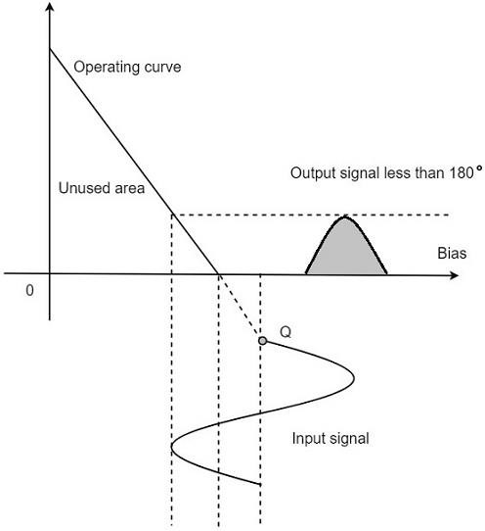
The following figure shows the operating
point and output of a class C amplifier

Slide 44
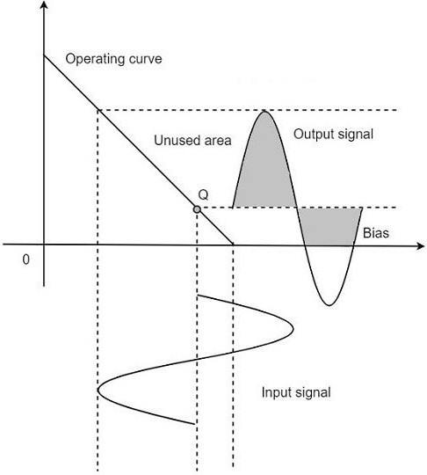
Class AB Power Amplifier
As the name implies, class AB is a combination of class A and class B type of amplifiers. As class A has the problem of low efficiency and class B has distortion problem, this class AB is emerged to eliminate these two problems, by utilizing the advantages of both the classes.

Slide 45
Class B Push-Pull Amplifier
Though the efficiency of class B power amplifier is higher than class A, as only one half cycle of the input is used, the distortion is high. Also, the input power is not completely utilized. In order to compensate these problems, the push-pull configuration is introduced in class B amplifier.
Construction
The circuit of a push-pull class B power amplifier consists of two identical transistors T₁ and T₂ whose bases are connected to the secondary of the center-tapped input transformer T_{r1}. The emitters are shorted and the collectors are given the V_{CC} supply through the primary of the output transformer T_{r2}.

Slide 46
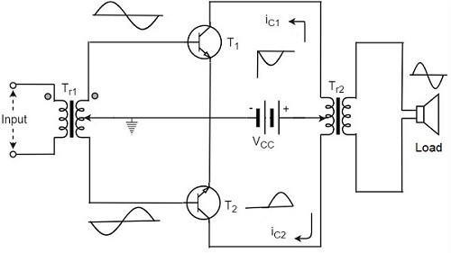
The circuit arrangement of class B push-pull amplifier, is same as that of class A push-pull amplifier except that the transistors are biased at cut off, instead of using the biasing resistors. The figure below gives the detailing of the construction of a push-pull class B power amplifier.

Slide 47
Operation
The circuit of class B push-pull amplifier shown in the above figure clears that both the transformers are center-tapped. When no signal is applied at the input, the transistors T₁ and T₂ are in cut off condition and hence no collector currents flow. As no current is drawn from V_{CC}, no power is wasted.
When input signal is given, it is applied to the input transformer T_{r1} which splits the signal into two signals that are 180º out of phase with each other. These two signals are given to the two identical transistors T₁ and T₂. For the positive half cycle, the base of the transistor T₁ becomes positive and collector current flows. At the same time, the transistor T₂ has negative half cycle, which throws the transistor T₂ into cutoff condition and hence no collector current flows.

Slide 48
Advantages:
High a.c. output is obtained.
The output is free from even harmonics.
The effect of ripple voltages are balanced out.
Disadvantages:
The transistors are to be identical, to produce equal
amplification.
Center-tapping is required for the transformers.
The transformers are bulky and costly.

Slide 49
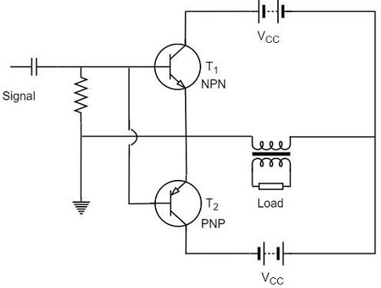
Complementary Symmetry Push Pull Class B Amplifier
The push pull amplifier which was just discussed improves efficiency but the usage of center-tapped transformers makes the circuit bulky, heavy and costly. To make the circuit simple and to improve the efficiency, the transistors used can be complemented, as shown in the following circuit diagram.

Slide 50
The above circuit employs a NPN transistor and a PNP transistor connected in push pull configuration. When the input signal is applied, during the positive half cycle of the input signal, the NPN transistor conducts and the PNP transistor cuts off. During the negative half cycle, the NPN transistor cuts off and the PNP transistor conducts.
In this way, the NPN transistor amplifies during positive
half cycle of the input, while PNP transistor amplifies during negative half cycle of the input. As the transistors are both complement to each other, yet acts symmetrically while configuration is connected in push pull class B circuit, so it is termed as complementary symmetry push pull amplifier

Slide 51
Advantages:
As there is no need of center tapped transformers, the weight and cost are reduced.
Equal and opposite input signal voltages are not
required.
Disadvantages:
It is difficult to get a pair of transistors (NPN and PNP) that have similar characteristics.
We require both positive and negative supply voltages.

Slide 52
UNIT-3
Feedback in Amplifiers

Slide 53
Feedback
The process of injecting a fraction of output energy of some device back to the input is known as Feedback. It has been found that feedback is very useful in reducing noise and making the amplifier operation stable.

Slide 54
Types of Feedbacks
Positive Feedback
The feedback in which the feedback energy i.e., either voltage or current is in phase with the input signal and thus aids it is called as Positive feedback.
Both the input signal and feedback signal introduces a phase shift of 180º thus making a 360º resultant phase shift around the loop, to be finally in phase with the input signal.

Slide 55
Negative Feedback
The feedback in which the feedback energy i.e., either voltage or current is out of phase with the input and thus opposes it, is called as negative feedback.
In negative feedback, the amplifier introduces a phase shift of 180º into the circuit while the feedback network is so designed that it produces no phase shift or zero phase shift. Thus the resultant feedback voltage V_{f} is 180º out of phase with the input signal V_{in}.

Slide 56
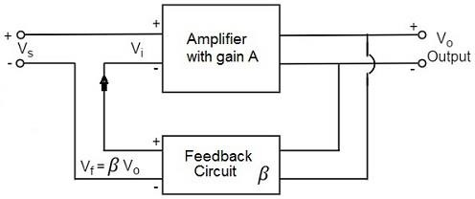
Principle of Feedback Amplifier
A feedback amplifier generally consists of two parts. They are the amplifier and the feedback circuit. The feedback circuit usually consists of resistors. The concept of feedback amplifier can be understood from the following figure:

Slide 57
From the above figure, the gain of the amplifier is represented as A. the gain of the amplifier is the ratio of output voltage V_{o} to the input voltage V_{i}. the feedback network extracts a voltage V_{f}= β V_{o} from the output V_{o} of the amplifier.
This voltage is added for positive feedback and subtracted for negative feedback, from the signal voltage V_{s}. Now,
    Vi=Vs+Vf=Vs+βVo
    Vi=Vs−Vf=Vs−βVo
The quantity β = V_{f}/V_{o} is called as feedback ratio or feedback fraction.

Slide 58
Let us consider the case of negative feedback. The output V_{o}must be equal to the input voltage (V_{s} - βV_{o}) multiplied by the gain A of the amplifier.
Hence,
(Vs−βVo)A=Vo
Or
AVs−AβVo=Vo
Or
AVs=Vo(1+Aβ)
Therefore,
Vo/Vs=A/1+Aβ

Slide 59
Let A_{f} be the overall gain (gain with the feedback) of the amplifier. This is defined as the ratio of output voltage V_{o} to the applied signal voltage V_{s}, i.e.
Af = Outputvoltage/Inputsignalvoltage=Vo/Vs
So, from the above two equations, we can understand that,
The equation of gain of the feedback amplifier, with negative feedback is given by
Af=A/1+Aβ
The equation of gain of the feedback amplifier, with positive feedback is given by
Af=A/1−Aβ
These are the standard equations to calculate the gain of feedback amplifiers.

Slide 60
Amplifiers Negative Feedback
There are two main types of negative feedback circuits. They are −
    Negative Voltage Feedback
    Negative Current Feedback
Negative Voltage Feedback
In this method, the voltage feedback to the input of amplifier is proportional to the output voltage.
    Voltage-series feedback
    Voltage-shunt feedback
Negative Current Feedback
In this method, the voltage feedback to the input of amplifier is proportional to the output current.
    Current-series feedback
    Current-shunt feedback

Slide 61
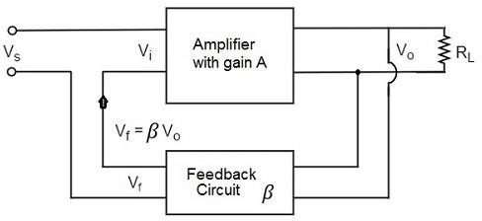
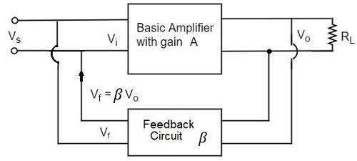
Voltage-Series Feedback
Voltage-Shunt Feedback

Slide 62
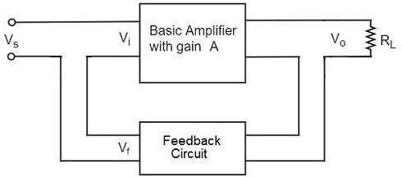
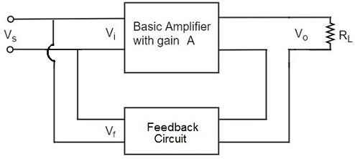
Current-Series Feedback
Current-Shunt Feedback

Slide 63
Advantages of negative feedback
Stability of gain is improved
Reduction in distortion
Reduction in noise
Increase in input impedance
Decrease in output impedance
Improve Bandwidth or Frequency response
Increase in the range of uniform application

Slide 64
Emitter Follower
Emitter follower is a case of negative current feedback circuit. This is mostly used as a last stage amplifier in signal generator circuits. The important features of Emitter Follower are −
It has high input impedance
It has low output impedance
It is ideal circuit for impedance matching
All these ideal features allow many applications for the emitter follower circuit. This is a current amplifier circuit that has no voltage gain.

Slide 65
Construction
The constructional details of an emitter follower circuit are nearly similar to a normal amplifier. The main difference is that the load R_{L} is absent at the collector terminal, but present at the emitter terminal of the circuit. Thus the output is taken from the emitter terminal instead of collector terminal.
The biasing is provided either by base resistor method or by potential divider method.

Slide 66
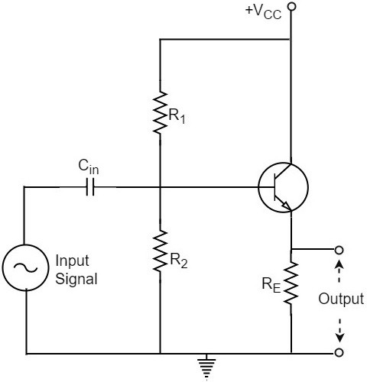
The following figure shows the circuit diagram of an Emitter Follower

Slide 67
Operation
The input signal voltage applied between base and emitter, develops an
output voltage V_{o} across R_{E}, which is in the emitter section. Therefore,
Vo=IERE
The whole of this output current is applied to the input through feedback. Hence,
Vf=Vo
As the output voltage developed across R_{L} is proportional to the emitter
current, this emitter follower circuit is a current feedback circuit. Hence,
β=Vf/Vo=1
It is also noted that the input signal voltage to the transistor (= V_{i}) is equal to the difference of V_{s} and V_{o} i.e.,
Vi=Vs−Vo
Hence the feedback is negative.

Slide 68
Characteristics
No voltage gain. In fact, the voltage gain is nearly 1.
Relatively high current gain and power gain.
High input impedance and low output impedance.
Input and output ac voltages are in phase.

Slide 69
UNIT-4
Sinusoidal Oscillators

Slide 70
Sinusoidal Oscillators
An oscillator generates output without any ac input signal.
An electronic oscillator is a circuit which converts dc energy
into ac at a very high frequency.
An amplifier with a positive feedback can be understood as an oscillator.

Slide 71
Alternator vs. Oscillator
An alternator converts mechanical energy to a.c. energy, whereas the oscillator converts d.c. energy into a.c. energy.
An oscillator can produce higher frequencies of several MHz whereas an alternator cannot.
An alternator has rotating parts, whereas an electronic oscillator doesn’t.
It is easy to change the frequency of oscillations in an oscillator than in an alternator.

Slide 72
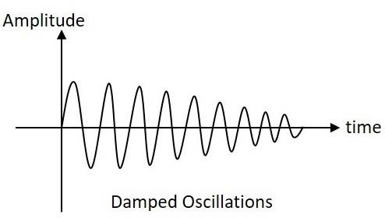
Nature of Sinusoidal Oscillations
Damped Oscillations
The electrical oscillations whose amplitude goes on decreasing with time are called as Damped Oscillations. The frequency of the damped oscillations may remain constant depending upon the circuit parameters.

Slide 73
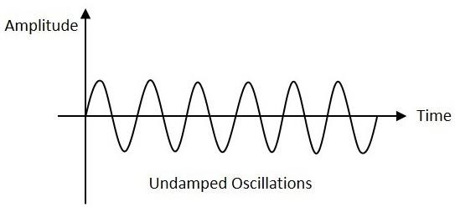
Undamped Oscillations
The electrical oscillations whose amplitude remains constant with time are called as Undamped Oscillations. The frequency of the Undamped oscillations remains constant.

Slide 74
The Oscillatory Circuit
An oscillatory circuit produces electrical oscillations of a desired frequency. They are also known as tank circuits.
A simple tank circuit comprises of an inductor L and a capacitor C both of which together determine the oscillatory frequency of the circuit.
To understand the concept of oscillatory circuit, let us consider the following circuit. The capacitor in this circuit is already charged using a dc source. In this situation, the upper plate of the capacitor has excess of electrons whereas the lower plate has deficit of electrons. The capacitor holds some electrostatic energy and there is a voltage across the capacitor.

Slide 75
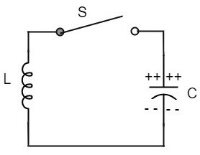
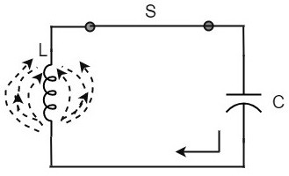
When the switch S is closed, the capacitor discharges and the current flows through the inductor. Due to the inductive effect, the current builds up slowly towards a maximum value. Once the capacitor discharges completely, the magnetic field around the coil is maximum.

Slide 76
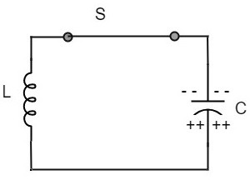
Now, let us move on to the next stage. Once the capacitor is discharged completely, the magnetic field begins to collapse and produces a counter EMF according to Lenz’s law. The capacitor is now charged with positive charge on the upper plate and negative charge on the lower plate.
Once the capacitor is fully charged, it starts to discharge to build up a magnetic field around the coil, as shown in the following circuit diagram.

Slide 77
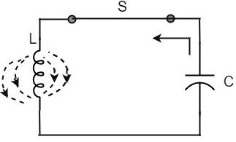
This continuation of charging and discharging results in alternating motion of electrons or an oscillatory current. The interchange of energy between L and C produce continuous oscillations.
In an ideal circuit, where there are no losses, the oscillations would continue indefinitely. In a practical tank circuit, there occur losses such as resistive and radiation losses in the coil and dielectric losses in the capacitor. These losses result in damped oscillations.

Slide 78
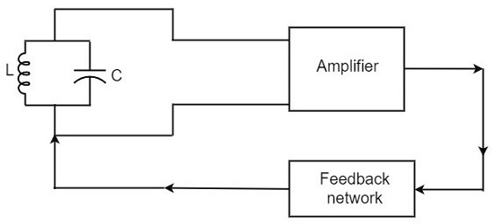
Practical Oscillator Circuit
Tank Circuit − The tank circuit consists of an inductance L connected in parallel with capacitor C. The values of these two components determine the frequency of the oscillator circuit.
Transistor Amplifier − The output of the tank circuit is connected to the amplifier circuit so that the oscillations produced by the tank circuit are amplified here. Hence the output of these oscillations are increased by the amplifier.
Feedback Circuit − The function of feedback circuit is to transfer a part of the output energy to LC circuit in proper phase. This feedback is positive in oscillators while negative in amplifiers.

Slide 79
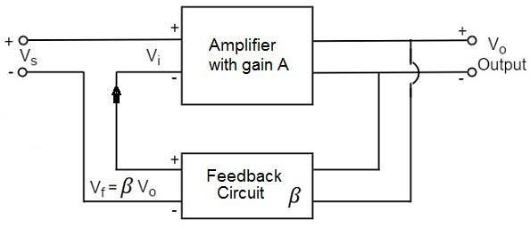
Principle of Feedback Amplifier
A feedback amplifier generally consists of two parts. They are the amplifier and the feedback circuit. The feedback circuit usually consists of resistors. The concept of feedback amplifier can be understood from the following figure below.
From the above figure, the gain of the amplifier is represented as A.

Slide 80
The gain of the amplifier is the ratio of output voltage Vo to the input voltage V_{i}. The feedback network extracts a voltage V_{f}= β V_{o} from the output V_{o} of the amplifier.
This voltage is added for positive feedback and subtracted for
negative feedback, from the signal voltage V_{s}.
So, for a positive feedback,
V_{i} = V_{s} + V_{f} = V_{s} + β V_{o}
The quantity β = V_{f}/V_{o} is called as feedback ratio or feedback
fraction.
+ βV_{o})
The output V_{o} must be equal to the input voltage (V_{s}
multiplied by the gain A of the amplifier. Hence,
(Vs+βVo)A=Vo Or
AVs+AβVo=Vo Or
AVs=Vo(1−Aβ)
Therefore , Vo/Vs=A/1−Aβ

Slide 81
Let A_{f} be the overall gain (gain with the feedback) of the amplifier. This is defined as the ratio of output voltage V_{o} to the applied signal voltage V_{s}, i.e.
Af=OutputVoltage/InputSignalVoltage=Vo/Vs
From the above two equations, we can understand that, the equation of gain of the feedback amplifier with positive feedback is given by
Af=A/1−Aβ
Where Aβ is the feedback factor or the loop gain.
If Aβ = 1, A_{f} = ∞. Thus the gain becomes infinity, i.e., there is output without any input. In another words, the amplifier works as an Oscillator.
The condition Aβ = 1 is called as Barkhausen Criterion of oscillations. This is a very important factor to be always kept in mind, in the concept of Oscillators.

Slide 82
Tuned Collector Oscillator
Tuned collector oscillators are called so, because the tuned circuit is placed in the collector of the transistor amplifier. The combination of L and C form the tuned circuit or frequency determining circuit.
Construction
The resistors R₁, R₂ and R_{E} are used to provide d.c. bias to the transistor. The capacitors C_{E} and C are the by-pass capacitors. The secondary of the transformer provides a.c. feedback voltage that appears across the base-emitter junction of R₁ and R₂ is at a.c. ground due to by-pass capacitor C. In case, the capacitor was absent, a part of the voltage induced in the secondary of the transformer would drop across R₂ instead of completely going to the input of transistor.

Slide 83
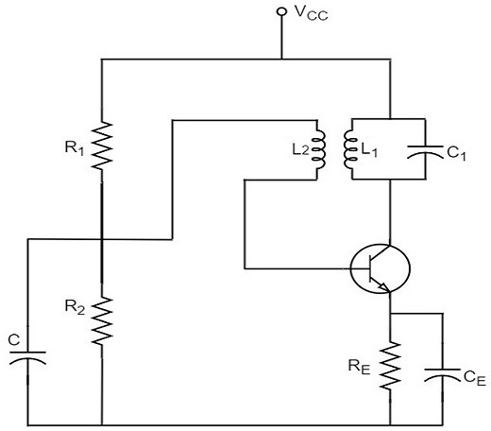
As the CE configured transistor provides 180º phase shift, another 180º phase shift is provided by the transformer, which makes 360º phase shift between the input and output voltages. The following circuit diagram shows the arrangement of a tuned collector circuit.

Slide 84
Operation
Once the supply is given, the collector current starts increasing and charging of capacitor C takes place. When the capacitor is fully charged, it discharges through the inductance L₁. Now oscillations are produced. These oscillations induce some voltage in the secondary winding L₂. The frequency of voltage induced in the secondary winding is same as that of the tank circuit and its magnitude depends upon the number of turns in secondary winding and coupling between both the windings.
The voltage across L₂ is applied between base and emitter and appears in the amplified form in the collector circuit, thus overcoming the losses in the tank circuit. The number of turns of L₂ and coupling between L₁ and L₂ are so adjusted that oscillations across L₂ are amplified to a level just sufficient to supply losses to the tank circuit.
Tuned collector oscillators are widely used as the local oscillator in radio
receivers.

Slide 85
Hartley Oscillator
A very popular local oscillator circuit that is mostly used in radio receivers is the Hartley Oscillator circuit.
Construction
In the circuit diagram of a Hartley oscillator shown below, the resistors R₁, R₂ and R_{e} provide necessary bias condition for the circuit. The capacitor C_{e} provides a.c. ground thereby providing any signal degeneration. This also provides temperature stabilization.
The capacitors C_{c} and C_{b} are employed to block d.c. and to provide an a.c. path. The radio frequency choke (R.F.C) offers very high impedance to high frequency currents which means it shorts for d.c. and opens for a.c. Hence it provides d.c. load for collector and keeps a.c. currents out of d.c. supply source

Slide 86
Tank Circuit
The frequency determining network is a parallel resonant circuit which consists of the inductors L₁ and L₂ along with a variable capacitor C. The junction of L₁ and L₂ are earthed. The coil L₁has its one end connected to base via C_{c} and the other to emitter via C_{e}. So, L₂ is in the output circuit. Both the coils L₁and L₂ are inductively coupled and together form an Auto- transformer.

Slide 87
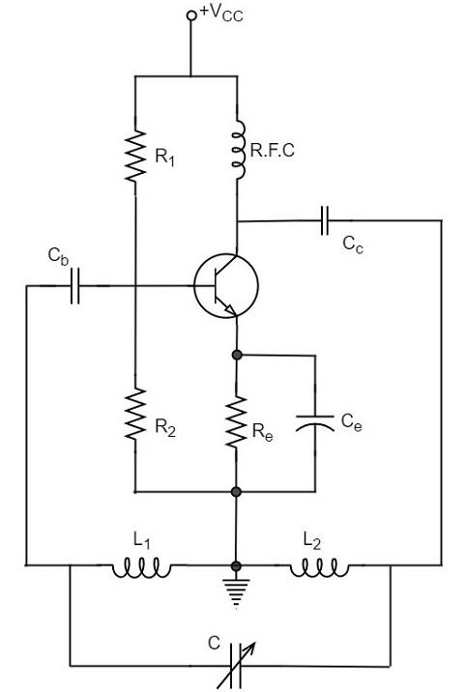
The following circuit diagram shows the arrangement of a Hartley oscillator. The tank circuit is shunt fed in this circuit. It can also be a series-fed.

Slide 88
Operation
When the collector supply is given, a transient current is produced in the oscillatory or tank circuit. The oscillatory current in the tank circuit produces a.c. voltage across L₁.
The auto-transformer made by the inductive coupling of L₁ and L₂ helps in determining the frequency and establishes the feedback. As the CE configured transistor provides 180º phase shift, another 180º phase shift is provided by the transformer, which makes 360º phase shift between the input and output voltages.
This makes the feedback positive which is essential for the condition of oscillations. When the loop gain |βA| of the amplifier is greater than one, oscillations are sustained in the circuit.

Slide 89
Operation
Frequency
The equation for frequency of Hartley oscillator is given as
f=1/√2πLTC
LT=L1+L2+2M
Here, L_{T} is the total cumulatively coupled inductance; L₁ and L₂represent inductances of 1st and 2nd coils; and M represents mutual inductance.
Mutual inductance is calculated when two windings are considered.

Slide 90
Advantages:
Instead of using a large transformer, a single coil can be used as an auto-transformer.
Frequency can be varied by employing either a variable capacitor or a variable inductor.
Less number of components are sufficient.
The amplitude of the output remains constant over a fixed
frequency range.
Disadvantages:
It cannot be a low frequency oscillator.
Harmonic distortions are present.
Applications
The applications of Hartley oscillator are
It is used to produce a sine wave of desired frequency.
Mostly used as a local oscillator in radio receivers.
It is also used as R.F. Oscillator.

Slide 91
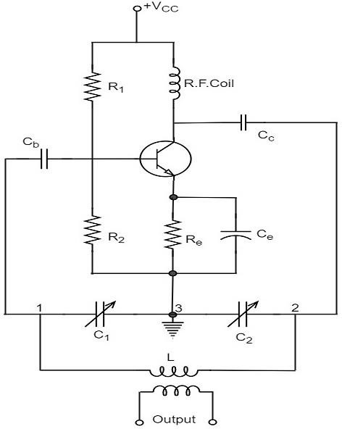
Colpitts Oscillator
A Colpitts oscillator looks just like the Hartley oscillator but the inductors and capacitors are replaced with each other in the tank circuit.

Slide 92
Frequency of Colpitts oscillator
The equation for frequency of Colpitts oscillator is given as
f=1√2πLCT
C_{T} is the total capacitance of C₁ and C₂ connected in series.
1/CT=1/C1+1/C2
CT=C1×C2 / C1+C2

Slide 93
Advantages
Colpitts oscillator can generate sinusoidal signals of very high frequencies.
It can withstand high and low temperatures.
The frequency stability is high.
Frequency can be varied by using both the variable capacitors.
Less number of components are sufficient.
The amplitude of the output remains constant over a fixed
frequency range.
Applications
Colpitts oscillator can be used as High frequency sine wave generator.
This can be used as a temperature sensor with some associated
circuitry.
Mostly used as a local oscillator in radio receivers.
It is also used as R.F. Oscillator.
It is also used in Mobile applications.
It has got many other commercial applications.

Slide 94
Phase Shift Oscillators
The oscillator circuit that produces a sine wave using a phase-
shift network is called as a Phase-shift oscillator circuit.
Construction
The phase-shift oscillator circuit consists of a single transistor amplifier section and a RC phase-shift network. The phase shift network in this circuit, consists of three RC sections. At the resonant frequency f_{o}, the phase shift in each RC section is 60ºso that the total phase shift produced by RC network is 180º.

Slide 95
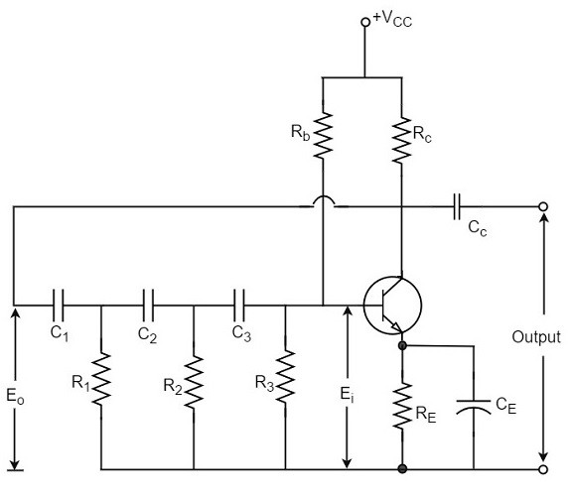
Circuit diagram of an RC phase-shift oscillator
The frequency of oscillations is given by
fo=1/2πRC√6
Where
R1=R2=R3=R & C1=C2=C3=C

Slide 96
Operation
The circuit when switched ON oscillates at the resonant frequency f_{o}. The output E_{o} of the amplifier is fed back to RC feedback network. This network produces a phase shift of 180ºand a voltage E_{i} appears at its output. This voltage is applied to the transistor amplifier.
The feedback applied will be m = Ei/Eo
The feedback is in correct phase, whereas the transistor amplifier, which is in CE configuration, produces a 180º phase shift. The phase shift produced by network and the transistor add to form a phase shift around the entire loop which is 360º.

Slide 97
Advantages
It does not require transformers or inductors.
It can be used to produce very low frequencies.
The circuit provides good frequency stability.
Disadvantages
Starting the oscillations is difficult as the feedback is small.
The output produced is small.

Slide 98
Wien Bridge Oscillator
Wien bridge oscillator circuit is mostly used because of its important features. This circuit is free from the circuit fluctuations and the ambient temperature.
The main advantage of this oscillator is that the frequency can be varied in the range of 10Hz to about 1MHz whereas in RC oscillators, the frequency is not varied.
Construction
The circuit construction of Wien bridge oscillator can be explained as below. It is a two-stage amplifier with RC bridge circuit. The bridge circuit has the arms R₁C₁, R₃, R₂C₂ and the tungsten lamp L_{p}. Resistance R₃ and the lamp L_{p} are used to stabilize the amplitude of the output.

Slide 99
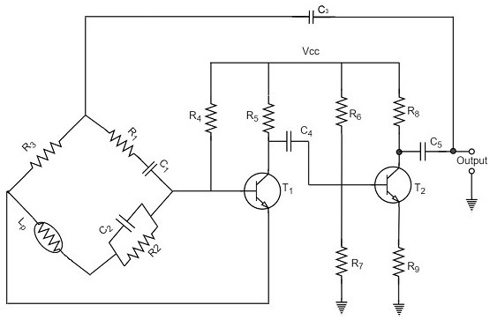
Circuit diagram a Wien bridge oscillator
The transistor T₁ serves as an oscillator and an amplifier while the other transistor T₂ serves as an inverter. The inverter operation provides a phase shift of 180º. This circuit provides positive feedback through R₁C₁, C₂R₂ to the transistor T₁ and negative feedback through the voltage divider to the input of transistor T₂.

Slide 100
Operation
When
the circuit is switched ON, the bridge circuit produces
oscillations of the frequency stated above. The two transistors produce a total phase shift of 360º so that proper positive feedback is ensured. The negative feedback in the circuit ensures constant output. This is achieved by temperature sensitive tungsten lamp L_{p}. Its resistance increases with current.
If the amplitude of the output increases, more current is produced and more negative feedback is achieved. Due to this, the output would return to the original value. Whereas, if the output tends to decrease, reverse action would take place.
Frequency
f=1/2π√R1C1R2C2
If R₁ = R₂ and C₁ = C₂ = C
Then, f=1/2πRC

Slide 101
Advantages
The circuit provides good frequency stability.
It provides constant output.
The operation of circuit is quite easy.
The overall gain is high because of two transistors.
The frequency of oscillations can be changed easily.
The amplitude stability of the output voltage can be maintained more accurately, by replacing R₂ with a thermistor.
Disadvantages
The circuit cannot generate very high frequencies.
Two transistors and number of components are required for
the circuit construction.

Slide 102
Crystal Oscillators
The principle of crystal oscillators depends upon the Piezo electric effect. The natural shape of a crystal is hexagonal. When a crystal wafer is cur perpendicular to X-axis, it is called as X-cut and when it is cut along Y-axis, it is called as Y-cut.
The crystal used in crystal oscillator exhibits a property called
as Piezo electric property.
Piezo Electric Effect
The crystal exhibits the property that when a mechanical stress is applied across one of the faces of the crystal, a potential difference is developed across the opposite faces of the crystal. Conversely, when a potential difference is applied across one of the faces, a mechanical stress is produced along the other faces.

Slide 103
Crystal Oscillator Circuit
A crystal oscillator circuit can be constructed in a number of ways like a Crystal controlled tuned collector oscillator, a Colpitts crystal oscillator, a Clap crystal oscillator etc. But
the transistor pierce crystal oscillator is the most commonly used one. This is the circuit which is normally referred as a crystal oscillator circuit.

Slide 104
circuit diagram crystal oscillator
In this circuit, the crystal is connected as a series element in the feedback path from collector to the base. The resistors R₁, R₂and R_{E} provide a voltage-divider stabilized d.c. bias circuit. The capacitor C_{E} provides a.c. bypass of the emitter resistor and RFC (radio frequency choke) coil provides for d.c. bias while decoupling any a.c. signal on the power lines from affecting the output signal. The coupling capacitor C has negligible impedance at the circuit operating frequency. But it blocks any d.c. between collector and base.

Slide 105
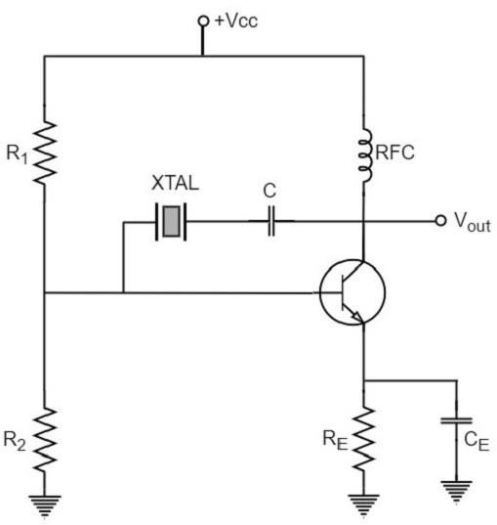
The circuit frequency of oscillation is set by the series resonant
frequency of the crystal and its value is given by the relation,
fo=1/√2πL.C

Slide 106
Advantages
They have a high order of frequency stability.
The quality factor (Q) of the crystal is very high.
Disadvantages
They are fragile and can be used in low power circuits.
The frequency of oscillations cannot be changed appreciably.

