Slide 1
Career Planning
Reporter: xx Date: 2019.6.14
SOLAR PANEL INSTALLATION AND MAINTENANCE
SEMESTER 5th

Slide 2
LEARNING OUTCOMES: At the end of the course, the students will be able to: Check site condition, collect tools and raw material
Install solar panel
Coordinate colleagues at workplace. Ensure safety at workplace

Slide 3
DETAIL CONTENTS
1. Check site conditions, collect tools and raw materials
1.1. Basics on solar energy and power generation systems
1.2. Use and handling procedure of solar panels
1.3. Energy storage, control and conversion
1.4. Basic electrical system and functioning
1.5. Mechanical equipment and its functioning
1.6. Maintenance procedure of equipment
1.7. Site survey, design and evaluation of various parameters
1.8. Tools involved in installation of system
1.9. Quality and process standards
1.10. Occupational health and safety standards

Slide 4
2. Installation of Solar Panel
2.1 Solar energy system components such as panels, batteries, charge controllers,
inverters
2.2 Significance of volts, amps and watts: series and parallel connection
2.3 Voltage requirement of various equipment
2.4 Panel mounting and inclination and angle of tilt
2.5 Placement of solar panel mounting
2.6 Sunlight and direction assessment
2.7 Site surveying methods and evaluation parameters
2.8 Tools involved in installation of system
3. Coordinate colleagues at work
3.1 Company’s policies on incentives, delivery standards, and personnel
management

Slide 5
3.2 Importance of the individual’s role in the workflow
3.3 Reporting structure
3.4 Communicating effectively
3.5 Building team coordination
4. Safety at workplace
4.1 Maintaining the work area safe and secure
4.2 Handling hazardous material
4.3 Operating hazardous tools and equipment
4.4 Emergency procedures to be followed such as fire accidents, etc.
5. Concept of Solar Tracking System

Slide 6
Chapter-1
Check site condition, collect tools and raw material
Introduction:- The demand for solar electric systems grows, progressive builders are adding solar photovoltaics (PV) as an option for their customers. This overview of solar photovoltaic systems will give the builder a basic understanding of:
• Evaluating a building site for its solar potential
• Common grid-connected PV system configurations and components
• Considerations in selecting components
• Considerations in design and installation of a PV system
• Typical costs and the labor required to install a PV system
• Building and electric code requirements
• Where to find more information

Slide 7
Basic on Solar energy
Solar energy is a powerful source of energy that can be used to heat, cool, and light homes and businesses.
Solar Energy Basics
Solar Photovoltaic Technology. Converts sunlight directly into electricity to power homes and businesses.
Passive Solar Technology. Provides light and harnesses heat from the sun to warm our homes and businesses in winter.
Solar Water Heating.
Solar Process Heat.
Concentrating Solar Power.

Slide 8
Power Generation system
Solar energy generation is one of fastest growing and most promising renewable energy sources of power generation worldwide. Nowadays, the electrical energy becomes one of the basic needs in our daily life, which makes increasing demand for it.
As a major source of electrical power generation fossil fuels are depleting day by day and also its usage raises serious environmental concerns. These reasons force the development of new energy sources which are renewable and ecologically safe.
The renewable energy sources include wind, solar, water, biomass and geothermal energy sources. Out of which, solar energy has the greatest potential in the long term and is predicted to play a major role in coming years. It is the cheapest method of generating electricity compared with other energy sources.

Slide 9
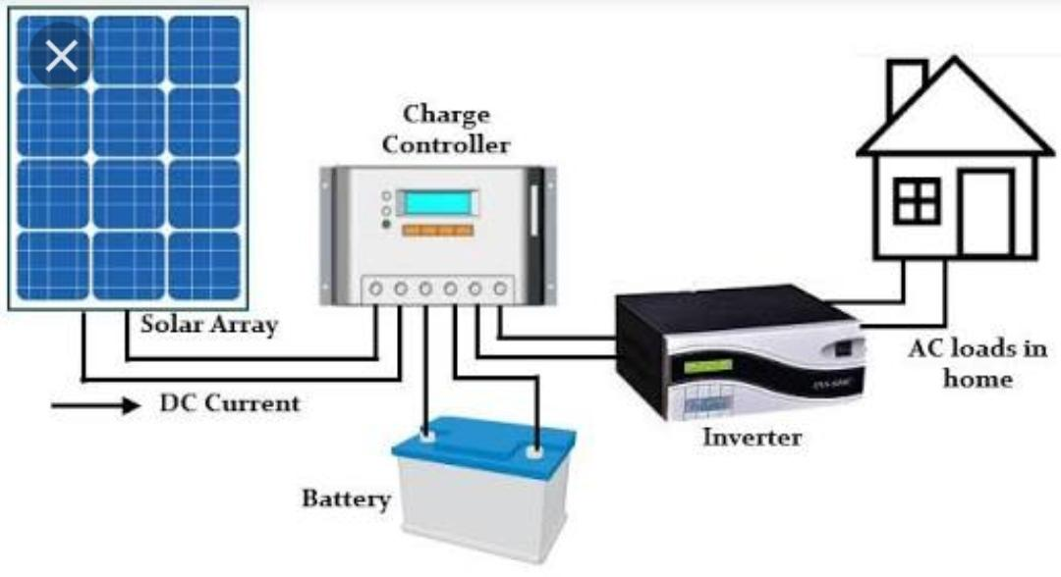
Solar-powered photovoltaic (PV) panels convert the sun's rays into electricity by exciting electrons in silicon cells using the photons of light from the sun. This electricity can then be used to supply renewable energy to your home or business.

Slide 10
Uses and handling procedure of solar panel:-
Uses:-
As heat for making hot water, heating buildings and cooking.
To generate electricity with solar cells or heat engines.
To take the salt away from sea water.
To use sun rays for drying clothes and towels.
It is used by plants for the process of photosynthesis.
Handling procedure of Solar panel:-
Solar panels are heavy and awkward to lift and carry. Loading and unloading panels from trucks and onto roofs can cause strains, sprains, muscle pulls and back injuries as well as cumulative trauma that stresses the spine. The panels can also heat up quickly when exposed to sunlight, causing burns if not handled safely.

Slide 11
Safety measures for solar workers:
Lift each solar panel with at least two people while applying safe lifting techniques.
Transport solar panels onto and around the work site using mobile carts or forklifts.
Never climb ladders while carrying solar panels. To get solar panels onto rooftops, use properly inspected cranes, hoists or ladder-based winch systems.
Once unpackaged, cover panels with an opaque sheet to prevent heat buildup.
Always wear gloves when handling panels.

Slide 12
Energy storage:-
One way solar power storage can be accomplished is by using a battery bank to store the electricity generated by the PV solar power system. A battery solar power storage system is used in a grid-tied PV system with battery backup and stand-alone PV systems.
The major components of a battery solar power system are...
Charge Controller: Prevents the battery bank from overcharging by interrupting the flow of electricity from the PV panels when the battery bank is full.
Battery Bank: A group of batteries wired together. The batteries are similar to car batteries, but designed specifically to endure the type of charging and discharging they'll need to handle in a solar power system.
System Meter: Measures and displays your solar PV systems performance and status.
Main DC Disconnect: A DC rated breaker between the batteries and the inverter. Allows the inverter to be quickly disconnected from the battery bank for service.

Slide 13
Lighting control - turns attached light on and off based on dusk and dawn. Many controllers are configurable, allowing settings for a few hours or all night, or somewhere in between.
Display- may show voltage of battery bank, state of charge, amps coming in from solar panel.
Conversion process:-
Photovoltaic energy is the conversion of sunlight into electricity. A photovoltaic cell, commonly called a solar cell or PV, is the technology used to convert solar energy directly into electrical power. A photovoltaic cell is a nonmechanical device usually made from silicon alloys.
Solar-powered photovoltaic (PV) panels convert the sun's rays into electricity by exciting electrons in silicon cells using the photons of light from the sun. This electricity can then be used to supply renewable energy to your home or business.

Slide 14
Control of Solar power
A solar charge controller manages the power going into the battery bank from the solar array. It ensures that the deep cycle batteries are not overcharged during the day, and that the power doesn't run backwards to the solar panels overnight and drain the batteries.
Types of controller:-
1. Pulse width modulation solar charge controller.
2. Maximum Power Point Tracking solar charge controller
The key features of solar charge controller:-
Multistage charging of battery bank:-changes the amount of power set to the batteries based on its charge level, for healthier batteries.
Low voltage disconnect - turns off attached load when battery is low and turns it back on when the battery is charged back up.

Slide 15
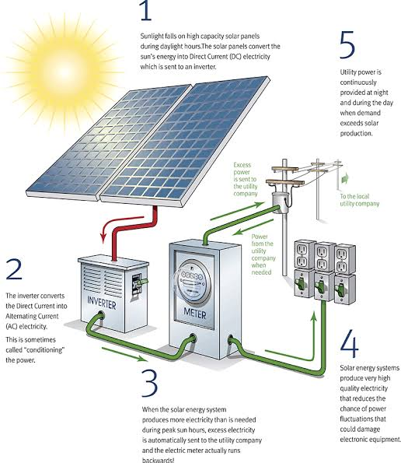
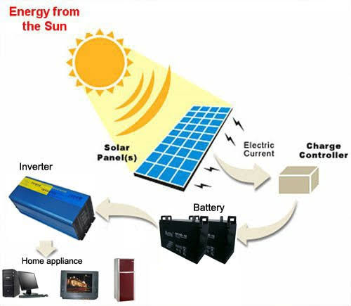
CONVERSION PROCESS

Slide 16
Basic electrical system and functioning
Components of A Residential Solar Electric System
Solar Panels. Solar panels are the most noticeable component of a residential solar electric system. ...
Solar Array Mounting Racks. ...
Array DC Disconnect. ...
Inverter. ...
Battery Pack. ...
Power Meter, Utility Meter, Kilowatt Meter. ...
Backup Generator. ...
Charge Controller.

Slide 17
Function of Solar Power:-
A solar power panel is able to function using the solar energy which is derived from the sun. ... The solar panels installed on the rooftops absorb sun's light (photons) from the sun. 2. The silicon and the conductors in the panel convert the sunlight into Direct Current (DC) electricity which then flow into the inverter.
It is important to understand exactly how solar panels work, and how they can be used to produce electricity for the average home.
1. The solar panels installed on the rooftops absorb sun’s light (photons) from the sun.
2. The silicon and the conductors in the panel convert the sunlight into Direct Current (DC) electricity which then flow into the inverter.

Slide 18
3. The inverter then converts DC to AC (alternating current) electrical power which you can use at your home.
4. Excess electricity that is not used by you can be fed back to the grid.
5. When your solar panels produce less power than what is required by you at home, you can always buy electricity from the utility.
Mechanical Equipment
Stringer machine for photovoltaic cells;
Layup station;
Automatic station with conveyor belts for manual bussing or Automatic Bussing Machine;
Electroluminescence Test;
Laminator with buffers;
Automatic framing machine;
Automatic silicone dispenser;
Eva and backsheet cutting machine;

Slide 19
Maintenance procedure of equipment
The timely and regular cleaning of solar cells and PV panels.
Regular maintenance of all thermal-based components.
Servicing of HT side equipment on an annual basis.
Diagnosis and tests pertaining to low solar power production.
Testing and upkeep of circuits.
Site Survey:-
What exactly is a Site Survey?
A Site Survey is done to collect information about various aspects such as local conditions, physical details of the site (including the roof), and the consumer’s power consumption needs. Some of the information collected is:
Local climatic conditions.
Physical details of the site (including the roof).
The consumer’s power consumption needs.
Shading on the roof and so on.

Slide 20
Site surveys are often done manually by skilled manpower, on the basis of which a 3D model of the site is prepared, which is used for the system design. A site survey consists of an inspection of the area of installation of solar panels to see if the proposed site is suitable. As a solar installer, when checking a potential site, you will primarily check for whether the roof will be able to support the extra load of the solar system, and if during peak hours there is no shade obstructing the panels.
The main objectives of a site survey are:
Ensure a site is free from shade due to obstacles such as water tanks, AC units, staircase, etc.
Clear access for maintenance at the site
Appropriate orientation to the sun
Obtain dimensions of the roof structure
Aesthetics of the installation
The energy consumption of the consumers.

Slide 21
Basic information about the site/location: Address/Plant Name: For identification Latitude and Longitude: For obtaining the satellite image of the site Details person at the plant (Name, Designation, E-Mail ID and Mob No): For contact details Information regarding the Electrical Energy Sources: Sanctioned load from the grid (kVA): Since state policy does not permit more than the specified amount, and varies for different states Connected Load Installed capacity & voltage of transformers Actual connected load (KVA) Power Units consumption per Month / Day Average Unit Cost – Grid

Slide 22
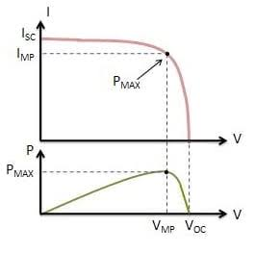
Important Parameters in Solar Panel Installations
Maximum Power (Pmax) Pmax is the highest power output of a solar panel under standard test conditions (STC). ...
Voltage at Maximum Power (Vmp) The Vmp is the voltage generated by the solar panel when the power output is highest. ...
Current at Maximum Power (Imp)

Slide 23
Tools involved in installation of system
Site Assessment Tools
50-100 ft. tape measure
Solar Pathfinder (evaluates the solar energy potential at a site)
Compass (not needed if you’re using a Solar Pathfinder)
Maps (reference for location latitude and magnetic declination)
Digital camera
Additional Tools to Consider (especially for multiple installations)
DC clamp-on ammeter
Reciprocating saw / Jig saw
Right angle drill
Conduit bender
Large crimpers
Magnetic wristband for holding bits and parts
C-clamp

Slide 24
Basic Tools Needed for Installation
Angle finder
Torpedo level
Fish tape
Chalk line
Cordless drill (14.4V or greater), multiple batteries
Unibit and multiple drill bits (wood, metal, masonry)
Hole saw
Hole punch
Torque wrench with deep sockets
Nut drivers (most common PV sizes are 7/16”, ½”, 9/16”)
Hacksaw
Tape measure
Blanket, cardboard or black plastic to keep modules from going “live” during installation
Heavy duty extension cords

Slide 25
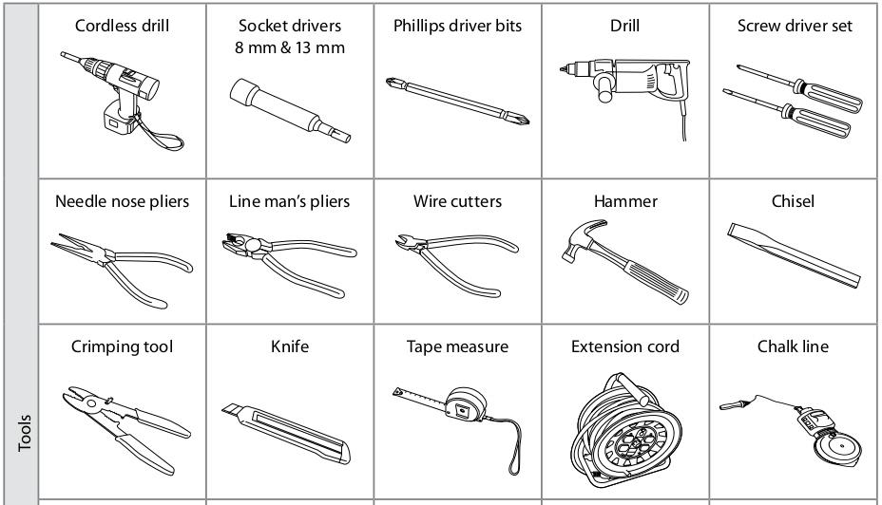

Slide 26
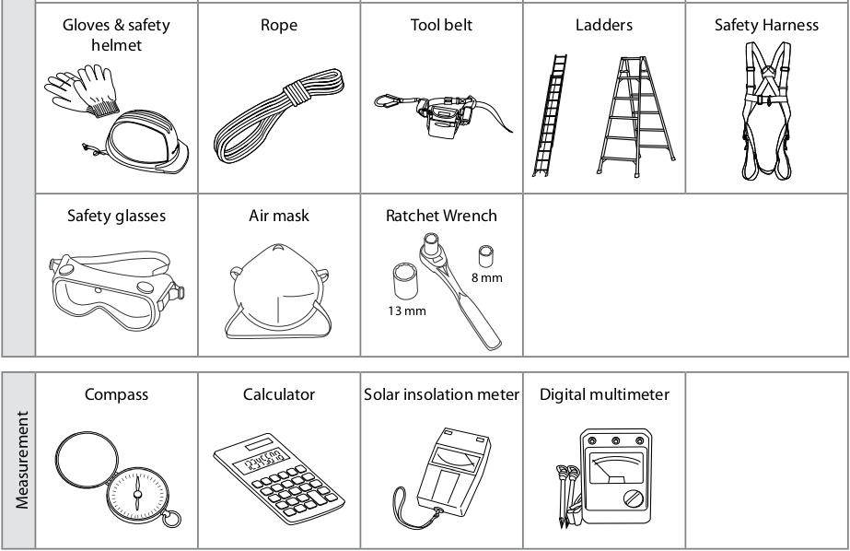

Slide 27
Quality and process standards
The quality of photovoltaic solar panels is an important factor to consider for any solar plant project on the roof or on the ground.
The qualities are following:-
The guarantee
Price
Manufacture, Solar panel technology
Efficiency of the solar panel
The by Pass box and the cables:
The frame of the solar panel:
Temperature coefficient
A high temperature coefficient is a sign of a lower quality solar panel. A reasonable number is around 0.5%, also the best solar panels down to 0.3% while 0.7% indicates a poor coefficient in terms of performance and thus a photovoltaic equipment not very reliable.

Slide 28
Standards generally used in photovoltaic modules:
IEC 61215 (crystalline silicon performance), 61646 (thin film performance) and 61730 (all modules, safety)
ISO 9488 Solar energy—Vocabulary.
UL 1703 from Underwriters Laboratories
UL 1741 from Underwriters Laboratories
UL 2703 from Underwriters Laboratories
CE mark
Electrical Safety Tester (EST) Series (EST-460, EST-22V, EST-22H, EST-110).

Slide 29
Safety measures for solar workers:
Lift each solar panel with at least two people while applying safe lifting techniques.
Transport solar panels onto and around the work site using mobile carts or forklifts.
Never climb ladders while carrying solar panels. To get solar panels onto rooftops, use properly inspected cranes, hoists or ladder-based winch systems.
Once unpackaged, cover panels with an opaque sheet to prevent heat buildup.
Always wear gloves when handling panels.

Slide 30
INSTALLATION OF SOLAR
PANEL
CHAPTER- 2
Solar energy system components:-
The four major components of a solar energy system are the panels, inverter(s), racking and solar battery storage unit(s) (if desired).
Panels
Solar panels are the most visible element of your system, which is why you’re likely the most familiar with it.The way that solar panels work is that the panels generate DC electricity as sunlight, or solar irradiation, stimulates electrons to move though solar cells that are in-built into the solar panels.

Slide 31
Technology – Polycrystalline or Monocrystalline Panels?
Monocrystalline panels consist of singular large crystals, are darker in colour, even in aesthetic consistancy and, as a result of the production process, the corners of cells are usually missing.
Polycrystalline panels consist of multiple smaller crystals, can be light or dark blue in colour and have variation in texture where some patches are lighter than others.
Inverters
Inverters are a crucial part of any solar energy system. Their purpose is to convert the DC electricity that the solar panels produce into 240V AC electricity, which is what powers everything in your home. The inverter is a hardworking piece of equipment that works constantly throughout the lifetime of your system – so it tends to be the piece most likely to have faults.

Slide 32
Racking
The third main component of a solar energy system is the racking/mounting. This is what securely attaches your panels to your roof. Racking / mounting will not be a decision you need to lose sleep over. Any reputable solar provider will use quality racking equipment from brands like Radiant or Sunlock, which are Australian made
Batteries
Batteries are used to store energy generated during the day to be used throughout the night when the system is no longer generating power. Battery technology is quickly developing into a more feasible option for those who primarily use their energy in the evenings. We have installed battery systems for major clients such as PCYC Queensland and schools like Bundaberg Christian College, who operate sporting facilities and boarding colleges that require energy throughout the night.

Slide 33
Charge controller
A charge controller is an important component in a battery based solar system and are not used in straight grid tie systems. The primary role is to manage charging the battery bank, prevent it from overcharging and many control the rate of the current and voltage at which it charges.
Series and Parallel Connection in Solar system
The following image is a great example of series and parallel wiring.
Series Wiring: Series wiring is when the voltage of a solar array is increased by wiring the positive of one solar module to the negative of another solar module. This is similar to installing batteries in a flashlight. As you slide the batteries into the flashlight tube the voltage increases

Slide 34
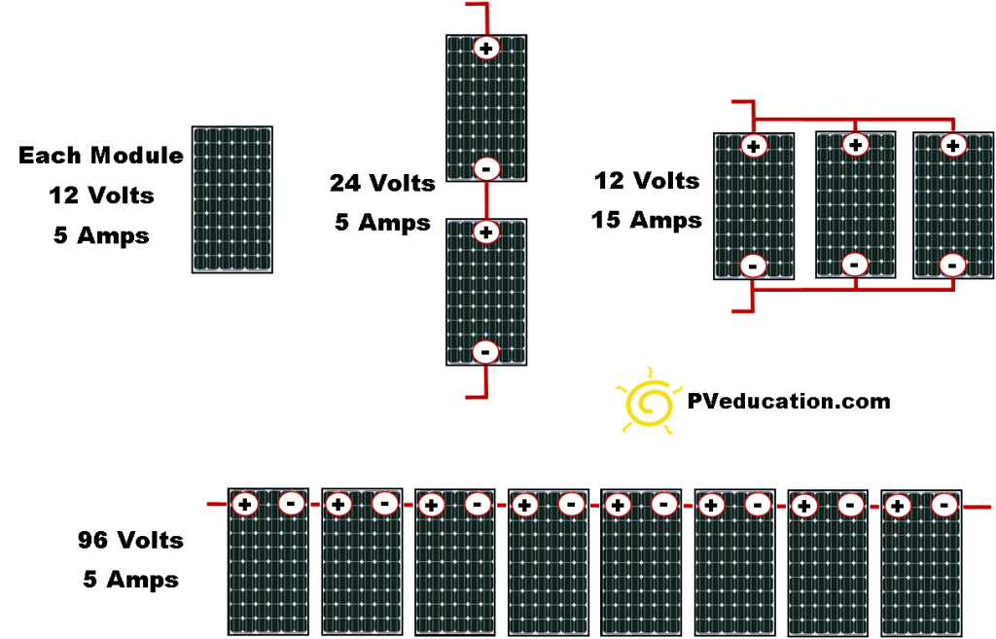
Parallel Wiring:
Parallel wiring increases the current (amps) output of a solar array while keeping the voltage the same. Parallel wiring is when the positives of multiple modules are connected together and all the negatives for the same modules are connected together.

Slide 35
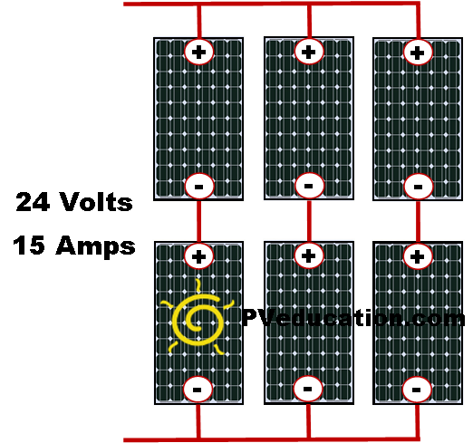
Series Parallel Combination:
Here is an example of what is found in most large solar systems, a series and parallel wiring combination.

Slide 36
Pole mounting
Photovoltaic mounting systems (also called solar module racking) are used to fix solar panels on surfaces like roofs, building facades, or the ground. These mounting systems generally enable retrofitting of solar panels on roofs or as part of the structure of the building (called BIPV).
Angle of tilt for Solar Panel:-
The “tilt angle” or “elevation angle” describes the vertical angle of your solar panels. “Azimuth angle” is their horizontal facing in relation to the Equator. Solar panels should face directly into the sun to optimize their output.
The optimum tilt angle is calculated by adding 15 degrees to your latitude during winter, and subtracting 15 degrees from your latitude during summer. For instance, if your latitude is 34°, the optimum tilt angle for your solar panels during winter will be 34 + 15 = 49°.

Slide 37
Placement of solar panel mounting
The most optimum direction to face your solar panels is somewhere between south and west. It is at this location that your panels will receive the maximum sunlight throughout the day.
If your roof does not face the right direction, then surface mounted panels or pole mounted panels may be your best bet.
Site Surveying Method
Roof Orientation and Shading Analysis- Helpful in in identifying the suitable location for Solar Panel installation.
Roofing Details – Study the roofing details to install the right solar PV system.
Load Analysis – Helpful to understand the energy needs of the building.

Slide 38
Evaluation parameters for Solar system:-
The following are the parameters you should evaluate on:
Grade – Solar panels come in Grades A, B & C (Grade A being the highest quality)
Tier of the manufacturer – Organizations such as BNEF have come up with ranking of the solar panel manufacturer, classifying them into one of three Tiers (Tier 1 being the highest)
Efficiency – Solar panels have efficiencies ranging from 13%-24%
Performance under low light conditions – Some solar panels can generate higher amounts of electricity than other panels with the same
Temperature coefficient – Solar panels with lower temperature coefficient (and higher temperature tolerance) lose less of their efficiency at higher temperatures
Warranties available – Solar panels come with performance warranties, which range from Standard to Linear
Presence of anti-PID features – Solar panels also come with features to tackle PID or Potential Induced Degradation, a characteristic that can cause significant harm to the panel within the first few years of installation.

Slide 39
Chapter- 4
SAFETY AT WORK PLACE
INTRODUCTION:- The Occupational Safety and Health Administration (OSHA) requires employers to implement safety training and protection for their employees. Many solar installation companies have taken OSHA’s requirements a step farther, creating manuals of their own that detail the specific measures they require to manage solar energy safely.
Maintaining the work area safe and secure:-
Every Worksite Presents Different Risks
No two worksites are the same. Before a solar installation begins, it’s essential for the installer to visit the site, identify the safety risks and develop specific plans for addressing them. Plans should include:

Slide 40
Equipment to be used for safe lifting and handling of solar panels
Type and size of ladders and scaffolding if needed
Fall protection for rooftop work
Personal protective equipment for each installer
All equipment needed for the job should be inspected and verified to be in good working order before being brought to the worksite.
Lifting and Handling Solar Panels
Solar panels are heavy and awkward to lift and carry. Loading and unloading panels from trucks and onto roofs can cause strains, sprains, muscle pulls and back injuries as well as cumulative trauma that stresses the spine. The panels can also heat up quickly when exposed to sunlight, causing burns if not handled safely.

Slide 41
Safety measures for solar workers:
Lift each solar panel with at least two people while applying safe lifting techniques.
Transport solar panels onto and around the work site using mobile carts or forklifts.
Never climb ladders while carrying solar panels. To get solar panels onto rooftops, use properly inspected cranes, hoists or ladder-based winch systems.
Once unpackaged, cover panels with an opaque sheet to prevent heat buildup.
Always wear gloves when handling panels.

Slide 42
Ladder Safety
Solar construction often involves working on roofs and from ladders. Choosing the right ladder and using it properly are essential.
Safety measures for solar workers:
Select the ladder that best suits the need for access – whether a stepladder, straight ladder or extension ladder. Straight or extension ladders should extend a minimum of three feet above the rung that the worker will stand upon.
Select the right ladder material. Aluminum and metal ladders are the most commonly used today and may have their place on the job, but they’re a serious hazard near power lines or electrical work. Use a fiberglass ladder with non-conductive side rails near power sources.

Slide 43
Trips and Falls
Trips and falls are a common hazard of all construction jobs, including solar. They can happen anywhere on the jobsite, especially off roofs or ladders. Rooftop solar installations are especially hazardous because the work space diminishes as more panels are installed, increasing the risk of falls.
Safety measures for solar workers:
Keep all work areas dry and clear of obstructions.
For fall distances of six feet or more, take one of three protective measures: install guardrails around ledges, sunroofs or skylights; use safety nets; or provide each employee with a body harness that is anchored to the rooftop to arrest a potential fall.
Cover holes on rooftops, including skylights, and on ground-level work surfaces

Slide 44
Solar Electrical Safety
Solar electric (photovoltaic or PV) systems include several components that conduct electricity: the PV solar array, an inverter that converts the panel’s direct current to alternating current, and other essential system parts. When any of these components are “live” with electricity generated by the sun’s energy, they can cause injuries associated with electric shock and arc-flash. Even low-light conditions can create sufficient voltage to cause injury.
Safety measures for solar workers:
Cover the solar array with an opaque sheet to “turn off” the sun’s light.
Treat the wiring coming from a solar PV array with the same caution as a utility power line. Use a meter or circuit test device to ensure that all circuits are de-energized before working on them.
Lock out the power on systems that can be locked out. Tag all circuits you’re working on at points where that equipment or circuit can be energized.

Slide 45
What are the hazards of solar power?
Hazards and Controls
Workers in the solar energy industry are potentially exposed to a variety of serious hazards, such as arc flashes (which include arc flash burn and blast hazards), electric shock, falls, and thermal burn hazards that can cause injury and death.
Handling hazardous material
Hazardous Waste or Not?
Solar panel waste can include heavy metals such as silver, lead, arsenic and cadmium that – at
certain levels – may be classified as hazardous waste.
Solar panels may be considered a waste when:
• A generator decides to discard unused solar panels: and
• Used solar panels are disconnected/removed from service and will not be reused.

Slide 46
It is important to remember that some types and brands of solar panels are hazardous waste
while other are not.
The following are some panels that do or may contain toxic material.
• CDTe solar panels may be a hazardous due to cadmium.
• Gallium arsenide (GaAs) panels may be hazardous due to arsenic.
• Some older silicon solar panels may be hazardous waste for hexavalent chromium coatings.
• Newer, thin-film solar panels contain CIS/CIGS and may be hazardous due to copper and/or
selenium.

Slide 47
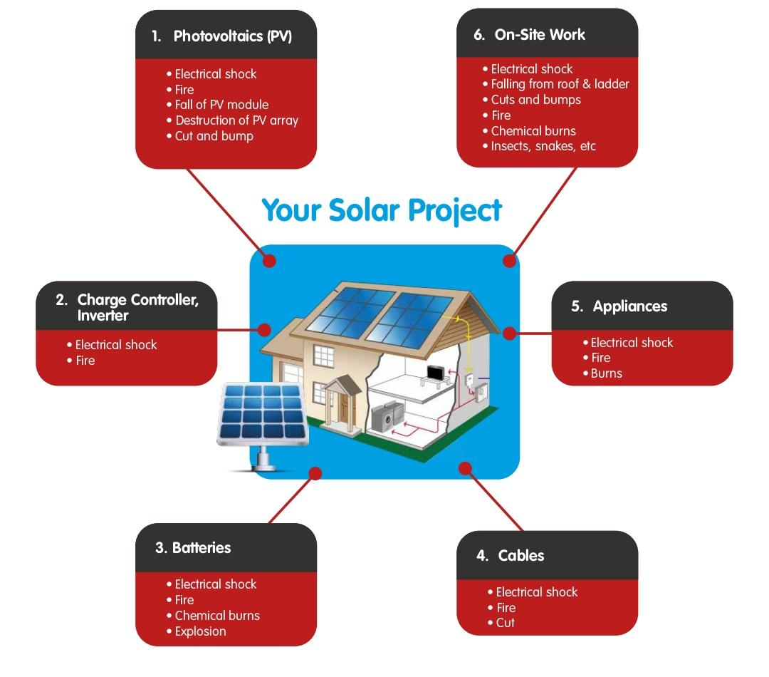
Site Risk & Hazard Assessment

Slide 48
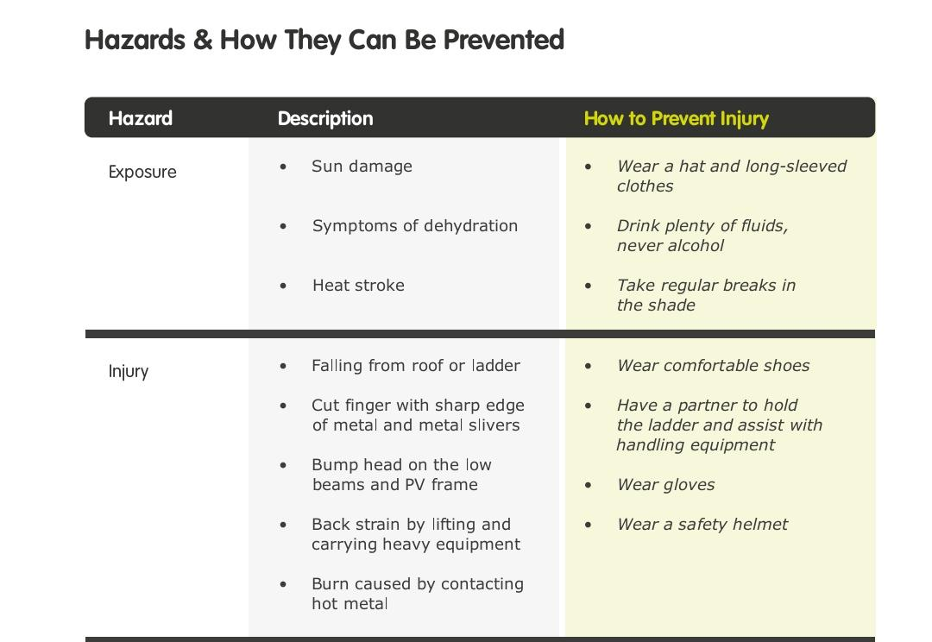

Slide 49
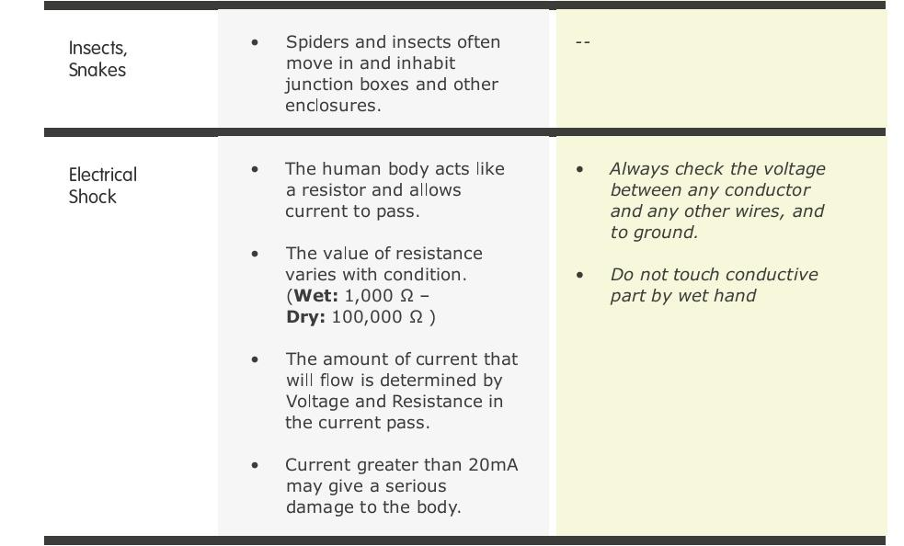

Slide 50
Chapter- 5
SOLAR TRACKING SYSTEM
Introduction:-Trackers direct solar panels or modules toward the sun. These devices change their orientation throughout the day to follow the sun's path to maximize energy capture. ... Because these trackers follow the sun vertically and horizontally they help obtain maximum solar energy generation.
What are solar trackers?
A solar tracking system maximizes your solar system’s electricity production by moving your panels to follow the sun throughout the day, which optimizes the angle at which your panels receive solar radiation. Solar trackers are typically used for ground-mounted solar panels and large, free-standing solar installations like solar trees.

Slide 51
When solar panels are exposed to sunlight, the angle at which the sun’s rays meet the surface of the solar panel (known as the “angle of incidence”) determines how well the panel can convert the incoming light into electricity. The narrower the angle of incidence, the more energy a photovoltaic panel can produce. Solar trackers help to minimize this angle by working to orient panels so that light strikes them perpendicular to their surface.
There are two types of solar tracking systems:
single-axis
dual-axis.
A single-axis tracker moves your panels on one axis of movement, usually aligned with north and south. These setups allow your panels to arc from east to west and track the sun as it rises and sets.

Slide 52
Single-axis trackers are nearly 32.17% efficient compared to a fixed solar tracker mount panel. These trackers follow the Sun from East to West, providing consistent power output all day long. The trackers generate 15-16% higher annual power as compared to a static station of the same installed capacity.
Disadvantages:-
Energy output is lower by single-axis tracker during sunny conditions compared to dual-axis trackers
Limited technological upgrade.
Solar trackers are slightly more expensive than their stationary counterparts, due to the more complex technology and moving parts necessary for their operation. This is usually around a $0.08 – $0.10/W increase depending on the size and location of the project.

Slide 53
Find the right solar setup for your property
Whether you want a ground-mounted solar array with solar trackers or a rooftop system, it is always important to compare your options before moving forward. On the EnergySage Solar Marketplace, you can solicit quotes for both ground-mounted and rooftop solar projects from qualified, pre-vetted installers in your area. If you are interested in a tracking system, simply leave a note on your profile that you would like quotes including solar trackers.

Slide 55
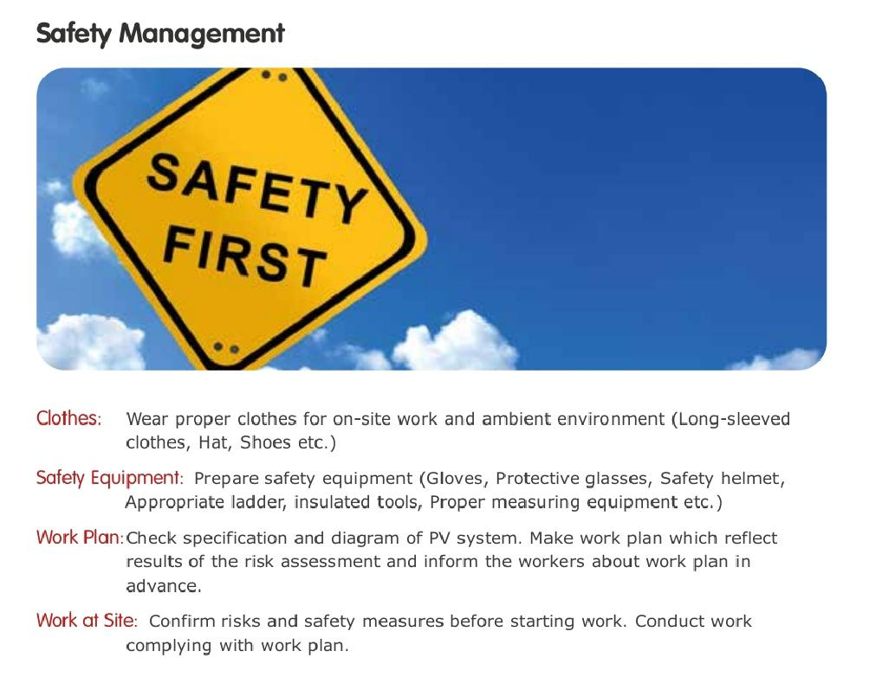

Slide 56
