Slide 1
Presentation
On
Subject
Instrumentation
ECE 5th Sem.

Slide 2
1. BASIC PRINCIPLES OF MEASUREMENTS. 1.1. Definition of measurement
1. BASIC PRINCIPLES OF MEASUREMENTS
1.1. Definition of measurement
Measurement is the acquisition of information about a state or phenomenon (object of measurement) in the world around us.
This means that a measurement must be descriptive (observable) with regard to that state or object we are measuring: there must be a relationship between the object of measurement and the measurement result.
Reference: [1]

Slide 3
MEASUREMENT THEORY FUNDAMENTALS.
“What is not measured does not exist.”
Max Born, 1926
Generic scheme of a measurement
E n v i r o n m e n t
Disturbance
Influence
x
+Δy
+Δ x
y
₁
Measurement
Object
Measurement
System
(noisy)
Observer
Matching
Matching
Influence
Influence

Slide 4
Measurement
Measurement is the process by which we convert physical parameters to meaningful numbers. The two basic requirements for the measurements are:
The standard used for comparison purpose must be accurately defined and commonly accepted.
The apparatus used and the method adopted must be provable.

Slide 5
Methods of Measurement
The methods of measurement are two categories.
Direct Method:- In these methods, the unknown quantity is directly compared against standard. The result is expressed as a numerical number and a unit.
Indirect method:- In this method we use an instrument which is called transducer. This method is also known as calibration method.

Slide 6
Signal Conditioning
In an instrument system there are three stages. The first stage is called detector transducer stage. The intermediate stage b/w first and third stage is called signal conditioning stage.

Slide 7
Display Devices
The last stage of a measurement system is the data presentation stage, which consists of data presentation elements. This stage consists of display devices.
The various digital display devices which are used are:
(i) LED (ii) LCD (iii) 7 Segment Display

Slide 8
LED(Light Emitting Diodes),LCD (Liquid Crystal Display), Seven Segment Display
LED :- The LED is a PN-junction device which emits light when a current passes through it in the forward direction.
LCD :- LCD are used in similar applications where LED are used. These applications are display of numeric and alphanumeric characters in dot matrix and segmental displays. The LCDs are of two types:
Dynamic scattering type
Field effect type
Seven Segmental Display:- It forms the digit to be displayed by illuminating proper segments from the group. By illuminating the proper combinations of these seven segments, number 0 to 9 can be displayed.

Slide 9
Diagram of LED(Light Emitting Diodes) LCD (Liquid Crystal Display)

Slide 10
Transducer
The device which converts an energy from one form to another is known as a transducer.
The input energy may be electrical, mechanical, chemical, thermal etc.

Slide 11
Electrical Transducers
The transducers which converts non electrical quantities (force, pressure, sound etc.) in to electrical quantities are called electrical transducers, it then becomes easier to measure a non electrical quantity.

Slide 12
Types of electrical Transducers
Resistance:- Potentiometer device, Resistance Strain Gauge, Pirani Gauge, resistance thermometer, thermistors.
Capacitance:- Variable capacitance pressure gauge, capacitor microphone, di-electric gauge.
Inductance:- Magnetic circuit transducer, reluctance pickup, differential transformer, magnetostriction.

Slide 13
Factors affecting the choice of the transducer
Linearity
Sensitivity
Accuracy
Insensitivity to unwanted signal
Loading effect
Errors
Electrical Aspects
Operating Range
Operating Principal
No Hysteresis
Stability

Slide 14
Different Types of Transducers
Passive Transducers:- These transducers are those that take the power for transduction from an external power source.
Active Transducers:- Those transducers are those that generate an electrical signal directly in response to the physical parameter, these are the transducers that do not require an auxiliary power source to produce their output.

Slide 15
Analog and Digital Transducers
Analog Transducer:- analog transducers are those that converts the input quantity into an analog output which is a continuous function of time.
Digital Transducers:- Digital Transducers are those that convert the input quantity into an electrical output which is in the form of pulses.

Slide 16
Potentiometer
Potentiometer:- It is a displacement transducer. It is a passive transducer. It is a variable transducers with 3 terminals. It consist of resistive material whose resistance is proportional to its length.
The movement of potentiometer slider may be- transnational type, Rotational type, Helix type

Slide 17
Starain Gauge
Strain Gauge is a thin, water like device that can be attached to variety of materials to measure strain. The strain gauge is a passive transducers. It converts a mechanical displacement into a change of resistance.
Gauge Factor:- It is defined as the ratio of per unit change in resistance, two per unit change in length.

Slide 18
LVDT
LVDT is a passive inductive transducers and is used to measure force (weight, pressure and acceleration etc.) in terms of the amount and direction of displacement of an object. It is used to translate linear motion into electrical signal.

Slide 19
Diagram of LVDT

Slide 20
Bimaterial thermometres
Method based on different thermal expansions of different metals
Other metal expands more than other: twisting
Inaccurary ± 1 ° C
Industry, sauna thermometres

Slide 21
Bimaterial thermometres

Slide 22
Electrical thermometres

Slide 23
Electrical thermometres
Resistive thermometres
Resistivity is temperature dependent
Materials: Platinum, nickel

Slide 24
Characteristic resistances

Slide 25
Thermistor thermometres
Semiconductor materials
Based on the temperature dependence of resistance
Thermal coefficient non-linear, 10 times bigger than for metal resistor
NTC, (PTC): temperature coefficient’s sign

Slide 26
Example of a characteristic curve

Slide 27
Limitations of electrical thermometres
Sensor cable’s resistance and its temperature dependency
Junction resistances
Thermal voltages
Thermal noise in resistors
Measurement current
Non-linear temperature dependencies
Electrical perturbations
Inaccuracy at least ± 0.1 °C

Slide 28
Infrared thermometres

Slide 29
Thermal radiation
Every atom and molecule exists in perpetual motion
A moving charge is associated with an electric field and thus becomes a radiator
This radiation can be used to determine object's temperature

Slide 30
Thermal radiation
Waves can be characterized by their intensities and wavelengths
The hotter the object:
the shorter the wavelength
the more emitted light
Wien's law:

Slide 31
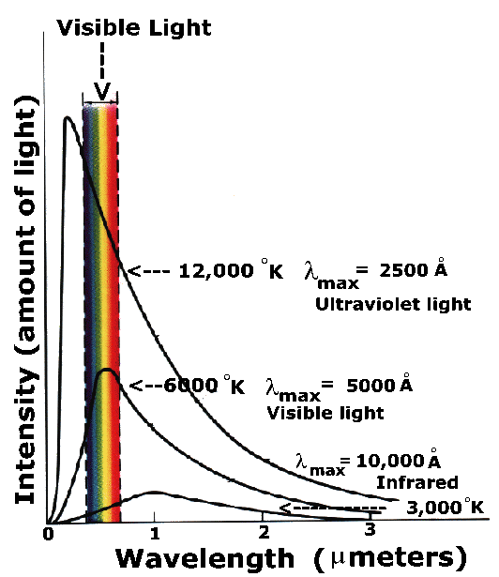
Planck's law
Magnitude of radiation at particular
wavelength (λ) and particular temperature
(T).
h is Planck’s constant and c speed of light.

Slide 32
Blackbody
An ideal emitter of electromagnetic radiation
opaque
non-reflective
for practical blackbodies ε = 0.9
Cavity effect
em-radiation measured from a cavity of an object

Slide 33
Cavity effect
Emissivity of the cavity increases and approaches unity
According to Stefan-Boltzmann’s law, the ideal emitter’s photon flux from area a is
In practice:

Slide 34
Cavity effect
For a single reflection, effective emissivity is
Every reflection increases the emyssivity by a factor (1-ε)

