Slide 1
Microcontrollers
Semester- 5th
Electronics and Communication Engg.
Raj Kumar

Slide 2
CHAPTER - 1
Microcontroller series (MCS) – 51 Overview

Slide 3
MICROCONTROLLER
An integrated circuit that contains a microprocessor along with memory, I/O ports and timer that controls the functions of an electronic device.
or
A Microcontroller is a microcomputer, which is designed to perform the specific tasks of embedded systems.

Slide 4
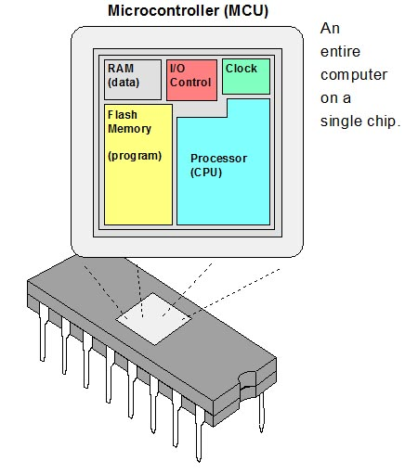

Slide 5
Difference between microprocessor and microcontroller
Microprocessor
It is a heart of computer system
Processor, memory and I/O components are connected externally
It consume high power
Do not have power saving features
Microprocessor is based on Von Neuman Architecture where all the data and codes are stored in same memory.
It has less number of registers
Cost of entire system increases.
Speed is slow
It is mostly used in personal computers
Microcontroller
It is a heart of embedded system
Processor, memory and I/O components all are connected inside microcontroller on a single chip
It consume low power
It has power saving features
Microcontroller is based on Harvard Architecture where data and program are stored in separate memory.
It has more number of registers
Cost of entire system decreases
Speed is fast
It is mostly used in washing machine and mp3 player

Slide 6
Applications
Washing machine
Microwave oven
Cameras
Keyboard controller
Modems
Security alarm system
Fire alarm system
Digital multimeters
Oscilloscope
Remote controls

Slide 7
Features of Microcontroller
It is an 8-bit microcontroller
4kb of ROM storage
128 bytes of RAM storage
Two 16-bit timers
It consists of are four parallel 8-bit ports, which are programmable as well as addressable as per the requirement.
crystal frequency of 12 MHz.
8 bit Stack Pointer
8 bit data bus
16 bit address bus

Slide 8
Features of Microcontroller
64K program memory space
64K data memory space
4 byte bidirectional input/output port (P0-P3)
UART(serial Port)
Two external and three internal interrupt
Power saving mode
8 bit CPU with register A and register B
8 bit program status word

Slide 9
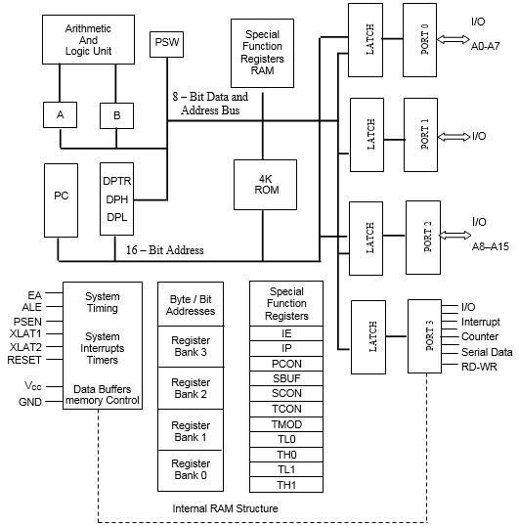
Architecture of Microcontroller

Slide 10
Memory
The memory which is used to store the program of the microcontroller is known as code memory or Program memory. It is known as ROM memory of microcontroller
The data memory of the 8051 is used to store data temporarily for operation is known RAM memory.
8051 microcontroller has 4K of code memory or program memory of ROM.
8051 microcontroller has 128 bytes of data memory of RAM.

Slide 11
BUS
Bus is a group of wires which work as a communication channel for transfer the data. These buses comprise 8, 16 or more cables.
There are two types of buses:
Address Bus: Microcontroller 8051 consists of 16-bit address bus. It is used to transmit the address from the Central Processing Unit to Memory.
Data Bus: Microcontroller 8051 consist of 8 bits data bus. which is used to carry data of particular applications.

Slide 12
I/O PORT
The 8051 has four important ports. Port 0, Port 1, Port 2 and Port 3.
These ports allow the microcontroller to connect with the outside world.
The four ports of 8051 microcontrollers have certain specific functions and corresponding features.
Each port has 8 pins. Thus the four ports jointly comprise 32 pins.
All ports are bidirectional.
They are constructed with a D type output latch. They have output drivers and input buffers.

Slide 13
COUNTERS/TIMERS
Microcontroller has two 16 bit timers or counters (T0 and T1) that count internal clock pulses or external clock pulses.
The timer registers can be used in two modes. These modes are Timer mode and the Counter mode.
In the timer mode, the internal machine cycles are counted.
In the counter mode, the external events are counted.
Special function registers TCON and TMOD are used for control/mode settings of the counters.

Slide 14
Program Counter
Microcontroller has16-bit program counter
It always points to the address of the next instruction to be executed. After execution of one instruction the program counter is incremented to point to the address of the next instruction to be executed.
Contents of PC are placed on address bus to find and fetch the desired instruction.
Since the PC is 16-bit width, 8051 can access program addresses from 0000H to FFFFH

Slide 15
Data Pointer
It is a 16-bit register which is the only user-accessible.
DPTR is used to point to data.
It is used by a number of commands which allow the 8051 to access external memory. When the 8051 accesses external memory it will access external memory at the address indicated by DPTR.
DPTR can also be used as two 8-registers DPH (data pointer high byte) and DPL (data pointer low byte).

Slide 16
Program Status Word (PSW)
The program status word contains information on the status of the CPU
The program status word (PSW) register is an 8-bit register, also known as flag register.
It is of 8-bit wide but only 6-bit are used.
The two unused bits are user-defined flags.
Four of the flags are called conditional flags, which means that they indicate a condition which results after an instruction is executed.
These four are CY(Carry), AC(auxiliary carry), P(parity), and OV(overflow).
The bits RS0 and RS1 are used to change the bank registers.

Slide 17
Program Status Word (PSW)
C: Carry Flag.
AC: Auxiliary Carry Flag indicates the carry from bit 3, is used for BCD operations.
F0: User Indicator or general purpose.
Ov: overflow indicator, when a drift in the 6th and 7th bit at a time.
P: parity indicator indicates 1 when the number is odd about the Acc.
Rs ₀ and Rs _{1:} Selection of bank records.

Slide 18
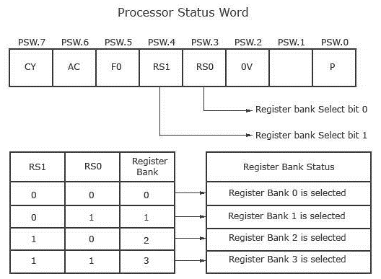
Program Status Word (PSW)

Slide 19
Program Status Word (PSW)
CY, the carry flag− This carry flag is set (1) whenever there is a carry out from the D7 bit. It is affected after an 8-bit addition or subtraction operation. It can also be reset to 1 or 0 directly by an instruction such as "SETB C" and "CLR C" where "SETB" stands for set bit carry and "CLR" stands for clear carry.
AC, auxiliary carry flag− If there is a carry from D3 and D4 during an ADD or SUB operation, the AC bit is set; otherwise, it is cleared. It is used for the instruction to perform binary coded decimal arithmetic.
P, the parity flag− The parity flag represents the number of 1's in the accumulator register only. If the A register contains odd number of 1's, then P = 1; and for even number of 1's, P = 0.

Slide 20
Program Status Word (PSW)
OV, the overflow flag− This flag is set whenever the result of a signed number operation is too large causing the high-order bit to overflow into the sign bit. It is used only to detect errors in signed arithmetic operations.
F0 Flag - The F0 flag are used for general-purpose and can be used by the programmer for any purpose. They are user definable.
RS0 and RS1 Flag − These registers are used to select register bank.

Slide 21
Stack Pointer
It is a 8 bit register.
Stack pointer is used to hold the internal RAM address to point to the top of the stack.
First SP is incremented for pushing data on the stack and then data byte is stored on the stack.
To get back the data from stack, first data byte is read from the stack and then SP is decremented.

Slide 22
Register A and B
Register A and B are 8 bit registers.
These are used to hold operands for ALU and results.
Register A is called Accumulator.
It is most widely used register.
It is used to transfer data between 8051 and any external memory.

Slide 23
Special Function Registers
A Special Function Register (or Special Purpose Register, or simply Special Register) is a register within a microprocessor that controls or monitors the various functions of a microprocessor
In the 8051, register A, B, DPTR, and PSW are a part of the group of registers commonly referred to as SFR (special function registers). An SFR can be accessed by its name or by its address.
SFR are used for specific functions.

Slide 24
Special Function Registers
The 8051 Microcontroller Special Function Registers are used to program and control different hardware peripherals like Timers, Serial Port, I/O Ports etc.
These internal register having address between 80H to FFH.

Slide 25
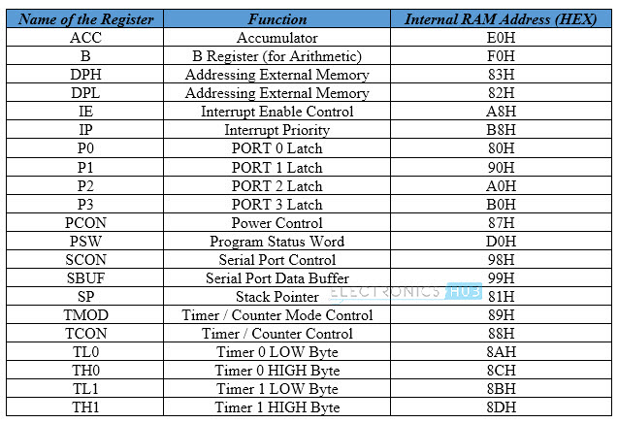
Special Function Registers

Slide 26
Chapter 2
Instruction Set

Slide 27
Instruction sets of 8051
The microcontroller 8051 instructions set includes 110 instructions, 49 of which are single byte instructions, 45 are two bytes instructions and 17 are three bytes instructions.
Instruction group are given as:
1. Data transfer group
2. Arithmetic group
3. Logical group
4. Bit manipulation group
5. Branching or Control transfer group.

Slide 28
Addressing Modes
The different ways in which a source operand in an instruction are known as the addressing modes. The 8051 provides a total of 5 distinct addressing modes.
There are six types of addressing modes.
Immediate Addressing Mode
Register Addressing Mode
Direct Addressing Mode
Register Indirect Addressing Mode
Indexed Addressing Mode
Implied Addressing Mode

Slide 29
1. Immediate addressing mode
In this Immediate Addressing Mode, the data is provided in the instruction itself. The data is provided immediately after the opcode. These are some examples of Immediate Addressing Mode.
MOVA, #0AFH;
MOVR3, #45H;
MOVDPTR, #FE00H;
2. Register addressing mode
In the register addressing mode the source or destination data should be present in a register (R0 to R7). These are some examples of RegisterAddressing Mode.
MOVA, R5;
MOVR2, #45H;
MOVR0, A;
3. Direct Addressing Mode
In the Direct Addressing Mode, the source or destination address is specified by using 8-bit data in the instruction. Only the internal data memory can be used in this mode. Here some of the examples of direct Addressing Mode.
MOV80H, R6;
MOVR2, 45H;
MOVR0, 05H;

Slide 30
4. Register indirect addressing Mode
In this mode, the source or destination address is given in the register. By using register indirect addressing mode, the internal or external addresses can be accessed. The R0 and R1 are used for 8-bit addresses, and DPTR is used for 16-bit addresses, no other registers can be used for addressing purposes. Let us see some examples of this mode.
MOV0E5H, @R0;
MOV@R1, 80H
5. Indexed addressing mode
In the indexed addressing mode, the source memory can only be accessed from program memory only. The destination operand is always the register A. These are some examples of Indexed addressing mode.
MOVCA, @A+PC;
MOVCA, @A+DPTR;
6. Implied Addressing Mode
In the implied addressing mode, there will be a single operand. These types of instruction can work on specific registers only. These types of instructions are also known as register specific instruction. Here are some examples of Implied Addressing Mode.
RLA;
SWAPA;

Slide 31
Timer Operation of 8051 MC
In Intel 8051, there are two 16-bit timer registers. These registers are known as Timer0 andTimer1. The timer registers can be used in two modes. These modes are Timer mode and the Counter mode. The only difference between these two modes is the source for incrementing the timer registers.
Timer Mode- In the timer mode, the internal machine cycles are counted.
Counter Mode- In the counter mode, the external events are counted.
There are four different modes of the Timer or Counter. The Mode 0 to Mode 2 are for both of the Timer/Counter. Mode 3 has a different meaning for each timer register.
TMOD Register
TMOD(Timer Mode) is an SFR. The address of this register is 89H. This is not bit-addressable.
Timer | Timer1 Mode |  |  |  | Timer0 Mode
Bit Details | Gate (G) | C/T | M1 | M0 | Gate (G) | C/T | M1 | M0

Slide 32

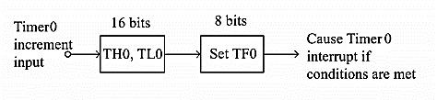
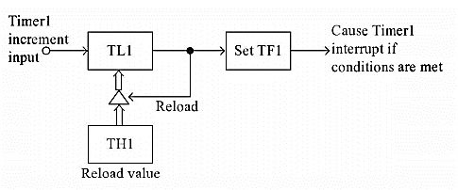
Mode 0 of Timer/Counter
The Mode 0 operation is the 8-bit timer or counter with a 5-bit pre-scaler. So it is a 13-bit timer/counter. It uses 5 bits of TL0 or TL1 and all of the 8-bits of TH0 or TH1.
Mode 1 of Timer/Counter
The Mode 1 operation is the 16-bit timer or counter. In the following diagram, we are using Mode 1 for Timer0.
Mode 2 of Timer/Counter
The Mode 2 operation is the 8-bit auto reload timer or counter. In the following diagram, we are using Mode 2 for Timer1.

Slide 33
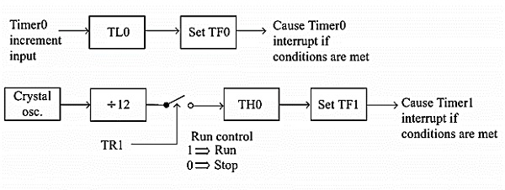
Mode 3 of Timer/Counter
Mode 3 is different for Timer0 and Timer1. When the Timer0 is working in mode 3, the TL0 will be used as an 8-bit timer/counter. It will be controlled by the standard Timer0 control bits, T0 and INT0 inputs. The TH0 is used as an 8-bit timer but not the counter. This is controlled by Timer1 Control bit TR1. When the TH0 overflows from FFH to 00H, then TF1 is set to 1. In the following diagram, we can Timer0 in Mode 3.

Slide 34
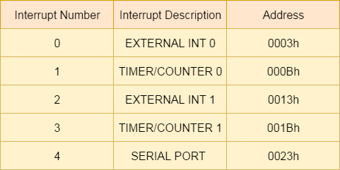
Interrupts in 8051
Interrupts are the events that temporarily suspend the main program, pass the control to the external sources and execute their task. 8051 has 5 interrupt signals:
1. Timer 0 overflow interrupt- TF0
2. Timer 1 overflow interrupt- TF1
3. External hardware interrupt- INT0
4. External hardware interrupt- INT1
5. Serial communication interrupt- RI/TI

Slide 35
Chapter 3
Assembly/C programming for Microcontroller

Slide 36
Assembler Directives
Assembler directives tell the assembler to do something other than creating the machine code for an
instruction. In assembly language programming, the assembler directives instruct the assembler to
1. Process subsequent assembly language instructions
2. Define program constants
3. Reserve space for variables
The following are the widely used 8051 assembler directives.
ORG (origin)
The ORG directive is used to indicate the starting address. It can be used only when the
program counter needs to be changed. The number that comes after ORG can be either in
hex or in decimal.
Eg: ORG 0000H ;Set PC to 0000.

Slide 37
EQU and SET
EQU and SET directives assign numerical value or register name to the specified symbol name
DB (DEFINE BYTE)
The DB directive is used to define an 8 bit data. DB directive initializes memory with 8 bit values. The numbers can be in decimal, binary, hex or in ASCII formats. For decimal, the 'D‘ after the decimal number is optional, but for binary and hexadecimal, 'B' and ‘H’ are required.
END
The END directive signals the end of the assembly module. It indicates the end of the
program to the assembler. Any text in the assembly file that appears after the END directive is ignored. If the END statement is missing, the assembler will generate an error message.

Slide 38
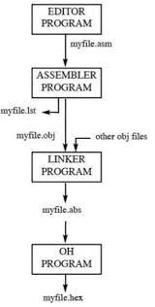
Assembler Operation
The assembly language is a fully hardware related programming language. The embedded designers must have sufficient knowledge on hardware of particular processor or controllers before writing the program. The assembly language is developed by mnemonics; therefore, users cannot understand it easily to modify the program. Microcontrollers or processors can understand only binary language in the form of ‘0s or 1s’; An assembler converts the assembly language to binary language, and then stores it in the microcontroller memory to perform the specific task.

Slide 39
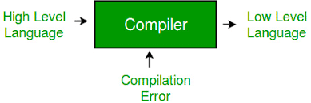
Compiler
Compiler is a program that transforms higher language source code(such as c code) to the lower language code(assembly language/machine code/binary code/object code).
Debugger
AA debugger is a computer program used by programmers to test and debug a target program. Debuggers may use instruction-set simulators, rather than running a program directly on the processor to achieve a higher level of control over its execution. This allows debuggers to stop or halt the program according to specific conditions. However, use of simulators decreases execution speed.
When a program crashes, debuggers show the position of the error in the target program. Most debuggers also are capable of running programs in a step-by-step mode, besides stopping on specific points. They also can often modify the state of programs while they are running. debugger is a software program used to test and find bugs (errors) in other programs.

Slide 40
Chapter 4
Design and Interface

Slide 41
Keyboard Interface
Keypads are widely used input devices being used in various electronics and embedded projects. They are used to take inputs in the form of numbers and albhabets, and feed the same into system for further processing.
The 8051 has 4 I/O ports P0 to P3 each with 8 I/O pins, P0.0 to P0.7,P1.0 to P1.7, P2.0 to P2.7, P3.0 to P3.7.
Make all rows of port P0 high so that it gives high signal when key is pressed.
See if any key is pressed by scanning the port P1 by checking all columns for non zero condition.
If any key is pressed, to identify which key is pressed make one row high at a time.
Initiate a counter to hold the count so that each key is counted.
Check port P1 for nonzero condition. If any nonzero number is there in [accumulator], start column scanning by following step 9.
Otherwise make next row high in port P1.

Slide 42
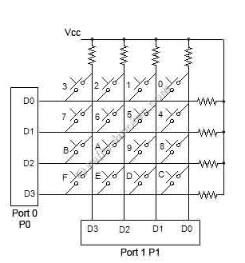
Add a count of 08h to the counter to move to the next row by repeating steps from step 6.
If any key pressed is found, the [accumulator] content is rotated right through the carry until carry bit sets, while doing this increment the count in the counter till carry is found.
Move the content in the counter to display in data field or to memory location
To repeat the procedures go to step 2.

Slide 43
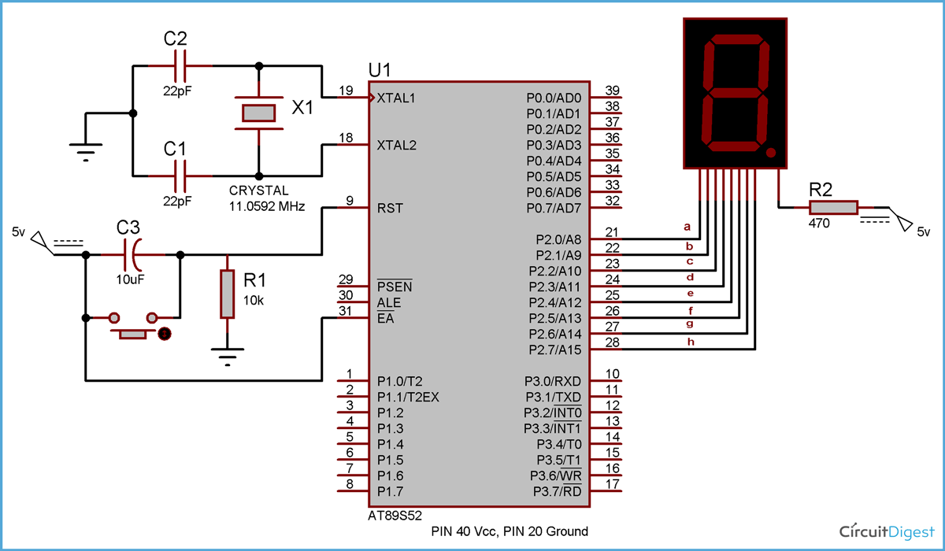
Seven Segment Interfacing with 8051

Slide 44
Seven segment displays are important display units in Electronics and widely used to display numbers from 0 to 9. It can also display some character alphabets like A,B,C,H,F,E etc. LEDs arranged as a group they can either have the anode in common or cathode thus they are named as Common-Anode/Common-Cathode displays.
Common Cathode: In this type of segments all the cathode terminals are made common and tied to GND. Thus the segments a to g needs a logic High signal(5v) in order to glow.
Common Anode: In this type of segments all the anodes terminals are made common and tied to VCC(5v). Thus the segments a to g needs a logic LOW signal(GND) in order to glow.
we have connected a,b,c,d,e,f,g,h to pins 2.0 to 2.7 port 2 of 8051.
Now suppose we want to display 0, then we need to glow all the LEDs except LED which belongs to line “g” (see diagram above), so pins 2.0 to 2.6 should be at 0 (should be 0 to TURN ON the LED as per negative logic) and pin 2.7 and 2.8 should be at 1 (should be 1 to TURN OFF the LED as per negative logic).
So the LEDs connected to pins 2.0 to 2.6 (a,b,c,d,e,f) will be ON and LEDs connected to 2.7 and 2.8 (g and h) will be OFF, that will create a “0” in 7 segment.

Slide 45
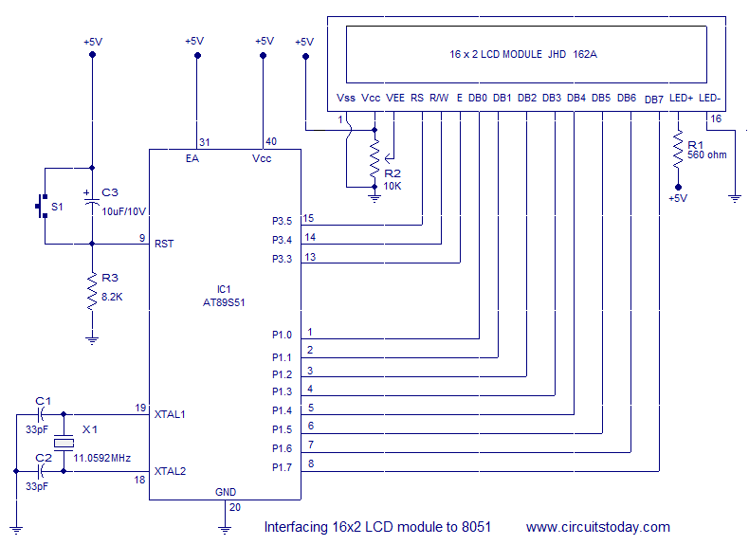
LCD Interfacing with 8051

Slide 46
16×2 LCD module is a very common type of LCD module that is used in 8051 based embedded projects. It consists of 16 rows and 2 columns of 5×7 or 5×8 LCD dot matrices.
VEE pin is meant for adjusting the contrast of the LCD display and the contrast can be adjusted by varying the voltage at this pin. This is done by connecting one end of a POT to the Vcc (5V), other end to the Ground and connecting the center terminal (wiper) of of the POT to the VEE pin. R/W pin is meant for selecting between read and write modes. High level at this pin enables read mode and low level at this pin enables write mode.
E pin is for enabling the module. A high to low transition at this pin will enable the module.
DB0 to DB7 are the data pins. The data to be displayed and the command instructions are placed on these pins.
LED+ is the anode of the back light LED and this pin must be connected to Vcc through a suitable series current limiting resistor. LED- is the cathode of the back light LED and this pin must be connected to ground.

Slide 47
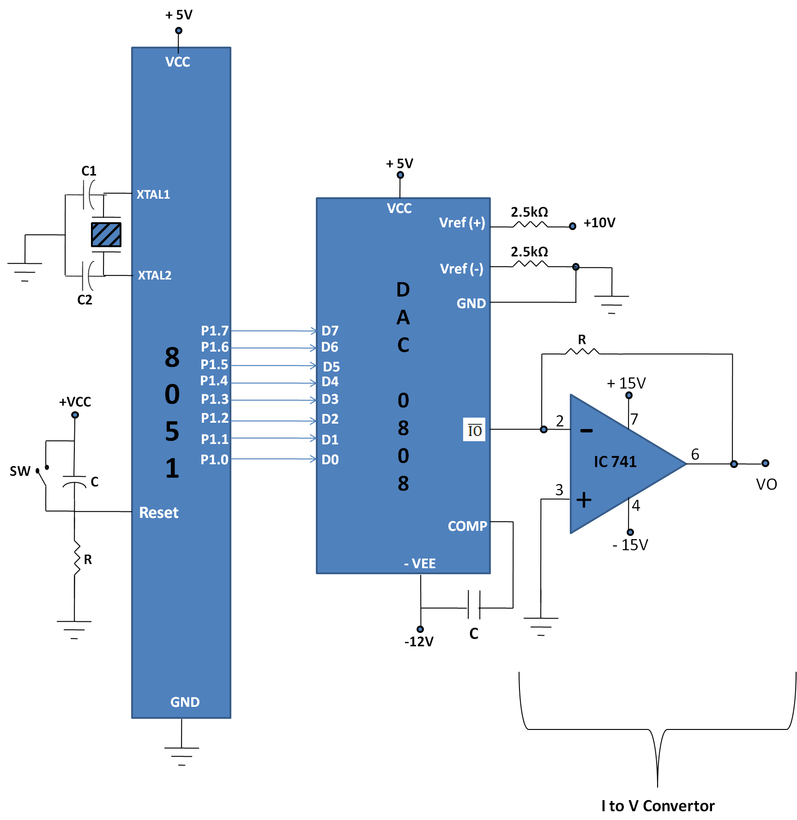
D/A Interfacing with 8051

Slide 48

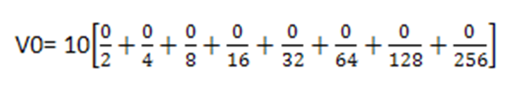
Microcontroller are used in wide variety of applications like for measuring and control of physical quantity like temperature, pressure, speed, distance, etc.
In these systems microcontroller generates output which is in digital form but the controlling system requires analog signal as they don't accept digital data thus making it necessary to use DAC which converts digital data into equivalent analog voltage.
In the figure shown, we use 8-bit DAC 0808. This IC converts digital data into equivalent analog Current. Hence we require an I to V converter to convert this current into equivalent voltage.
According to theory of DAC Equivalent analog output is given as:
1. IF data =00H [00000000], Vref= 10V
Therefore, V0= 0 Volts.

Slide 49
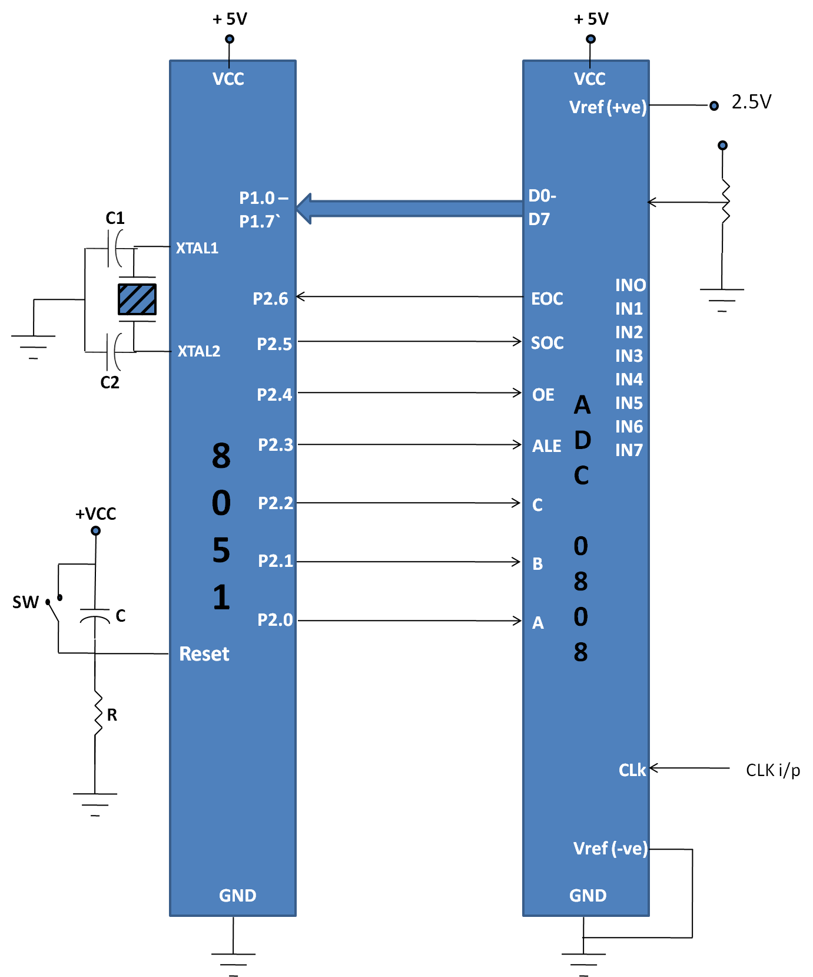
A/D Interfacing with 8051

Slide 50
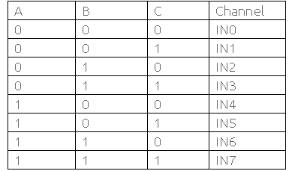
The ADC 0808/0809 is the 8-bit analog to digital converter.
It has 8-channels IN0-IN7.
It has three address lines i.e. Pin A,B,C and ALE are used to select one of the analog channel of total 8 channels as shown below:

Slide 51
ADC 0808 has 3 control signals:
SOC [Start of conversion]: When High to low signal is appears to this pin of ADC, ADC then starts conversion. Interfacing ADC(Analog to Digital Convertor) with 8051
EOC [End of conversion]: ADC sends this high EOC signal to Micro-Controller to indicate completion of conversion.
OE [Output Enable]: When a high signal is applied to this pin, The output latch of ADC get enables and the converted data is then available to Micro-Controller.
The reference voltage determines the range of analog input voltage. For example: - If reference voltage is 5V then analog voltage range is from 0V-5V. If the reference voltage is 2.56V then the Analog signal range is from 0V-2.56V.
The frequency of clock signal applied determines the conversion speed.

Slide 52
RTC Interfacing with 8051
The real-time clock's basic function is to produce intervals of one second and maintain a continuous count.
Address and data are transferred serially through an I²C, bidirectional bus. The clock/calendar provides seconds, minutes, hours, day, date, month, and year information.
The end of the month date is automatically adjusted for months with fewer than 31 days, including corrections for leap year.
The clock operates in either the 24-hour or 12-hour format with AM/PM indicator.
56-Byte, Battery-Backed, General-Purpose RAM with Unlimited Writes
Programmable Square-Wave Output Signal
Simple Serial Port Interfaces to Most Microcontrollers
I2C Serial Interface
Low Power Operation Extends Battery Backup Run Time
Consumes Less than 500nA in Battery-Backup Mode with Oscillator Running
Automatic Power-Fail Detect and Switch Circuitry

Slide 53
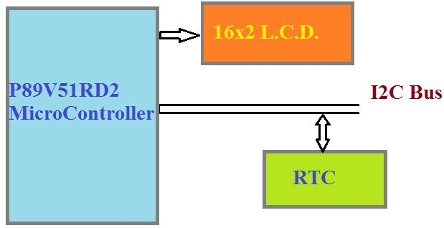

Slide 54
Chapter 5
Introduction of PIC Microcontrollers

Slide 55
PIC (Peripheral Interface Controller)
PIC microcontrollers ( Programmable Interface Controllers), are electronic circuits that can be programmed to carry out a vast range of tasks. They can be programmed to be timers or to control a production line and much more.
They are found in most electronic devices such as alarm systems, computer control systems, phones, in fact almost any electronic device
Currently it is named as Programmable Intelligent Computer
It contains high performance RISC CPU.
It is a 8-bit microcontroller. Therefore, the size of data bus is 8 bits.
It has 18 pins.

Slide 56
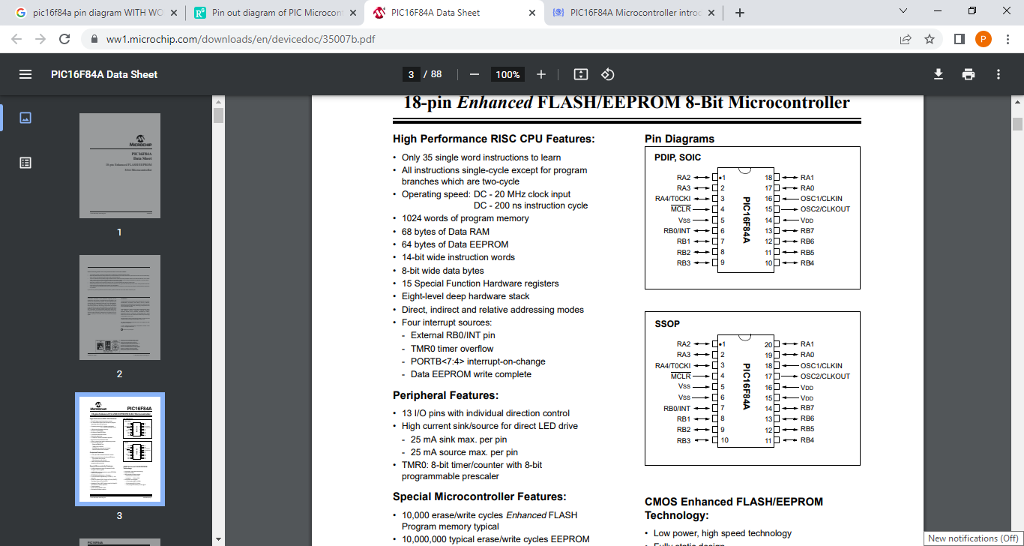
Pin Diagram of PIC

Slide 57
It has 13 GPIO pins and each pin can be used either as digital input or digital output.
These 13 GPIO pins are shared with PORTA and PORTB.
PORTA consists of 5 pins from RA0-RA4 and PORTB has 8 pins from RB0-RB7.
Pins 1,2,3,6,7,8,9,10,11,12,13,17&18:
These 13 GPIO pins can be independently configured either as digital input or as digital output.
The mentioned 13 I/O pins are assembled into two groups known as ports.
Port A: contains 5 pins which are 1, 2, 3, 17 & 18 on pinout or RA0, RA1,RA2,RA3,RA4.
Port B: contains 8 pins which are 6, 7, 8, 9, 10, 11, 12 & 13 or RB0, RB1, RB2, RB3, RB4, RB5, RB6, RB7.
Pin 4: This is an active low pin known as MCLR (Memory Clear). Obviously, this pin is used to reset the device . Whenever it is kept low while connecting to the ground then it reset the device. Circuit below shows the reset circuit in blue color highlighted region. When user will press the push button, device will reset, otherwise it will remain on.
Pin 5: This is the ground pin of the IC and must be associated with the negative terminal of the battery or supply voltage.

Slide 58
Pin 14: This is a supply pin and must be connected to the positive terminal of the power supply. The operating voltage of this device is 5 volts.
Pin 15 & 16: This is where crystal oscillator connected and the maximum frequency can be used is 20MHz. you can also use a 4MHz crystal but the higher the frequency of crystal used, the quicker the controller works. Also, at higher frequency, power consumption is also higher. Oscillators are connected to both pins OSC1 and OSC2 across 20MHz crystal through two 22pF capacitors.

Slide 59
Features of PIC
Only 35 single word instructions to learn
• Operating speed: DC - 20 MHz clock input
• 1024 words of program memory
• 68 bytes of Data RAM
• 64 bytes of Data EEPROM
• 14-bit wide instruction words
• 8-bit wide data bytes
• 15 Special Function Hardware registers
• Eight-level deep hardware stack
• Four interrupt sources:
- External RB0/INT pin
- TMR0 timer overflow
Peripheral Features:
• 13 I/O pins with individual direction control
• TMR0: 8-bit timer/counter with 8-bit
programmable prescaler

Slide 60
Advantages
Reliable
Performance very fast
Low cost
Support SPT, I2C, USART
Simple to program
Low power Consumption
Malfunctioning of PLC is very less

Slide 61
Applications
Electronic voting machine
Smart phone
Alarm system
Embedded system
Computer control system
Video games
Audio Accessories
Advanced medical devices

Slide 62
Thank You

